Slide 1


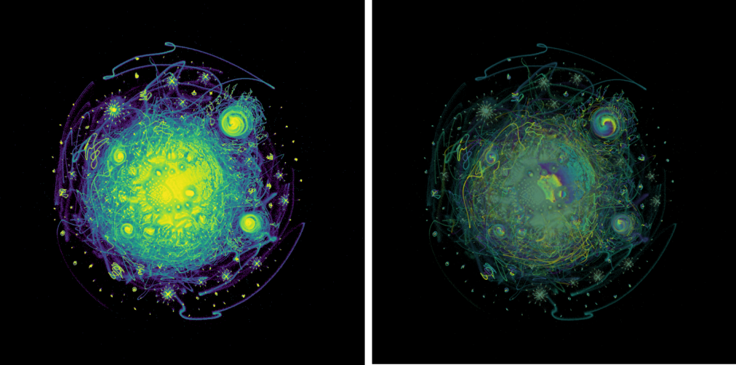



Dimension Reduction and UMAP for Omics Integration
Physalia course, online via zoom Nikolay Oskolkov, MRG Group Leader, LIOS, Riga, Latvia
@NikolayOskolkov
@oskolkov.bsky.social
Personal homepage: https://nikolay-oskolkov.com
Image adapted from McInnes et al. 2018

Slide 2
Dimensionality reduction is also supposed to ... reduce dimensions

Slide 3

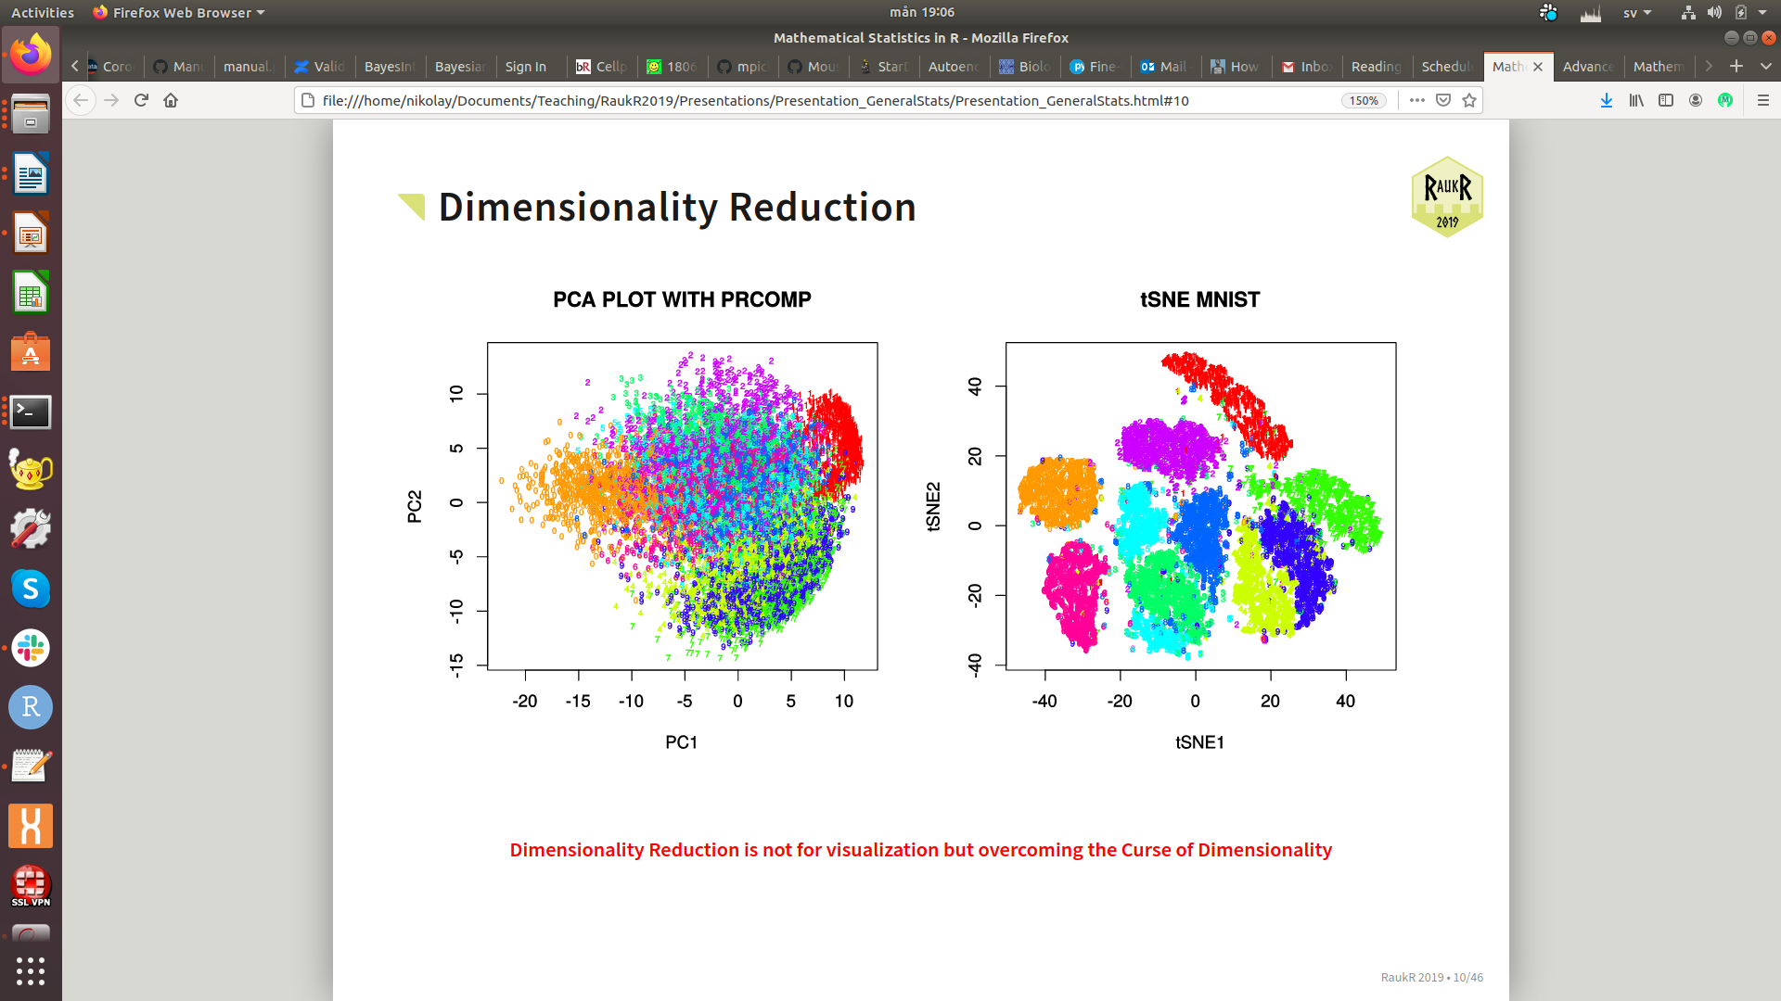
Dimension reduction: more than visualization
The goal of dimension reduction is not only visualization but also reducing dimensions

Slide 4
Dimension reduction techniques:
linear vs. non-linear

Slide 5
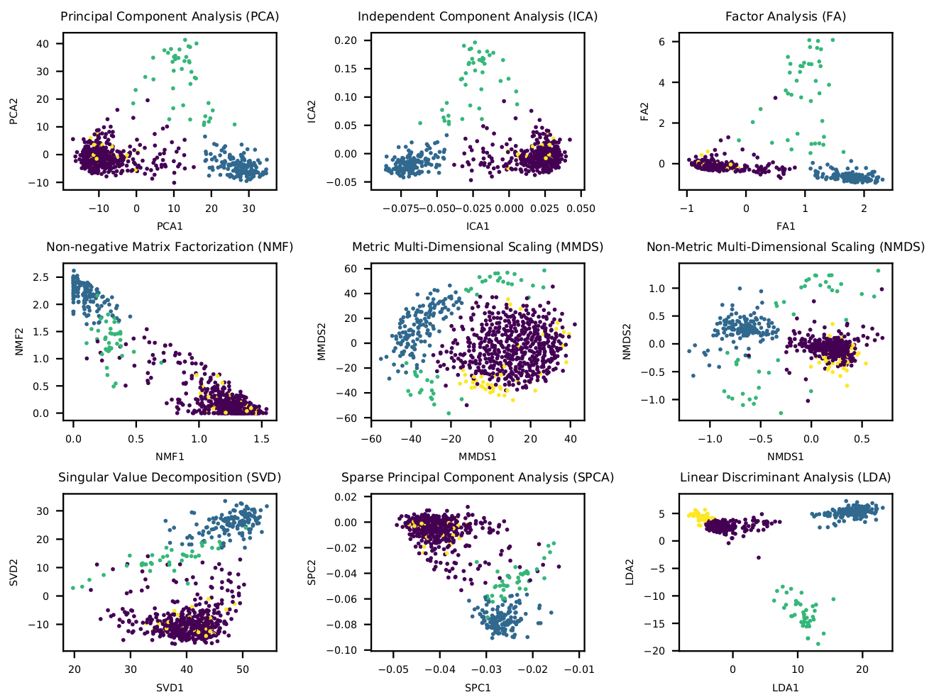
Linear dimensionality reduction
M. Bartoschek, N. Oskolkov et al.,
Nature Communications 2018

Slide 6
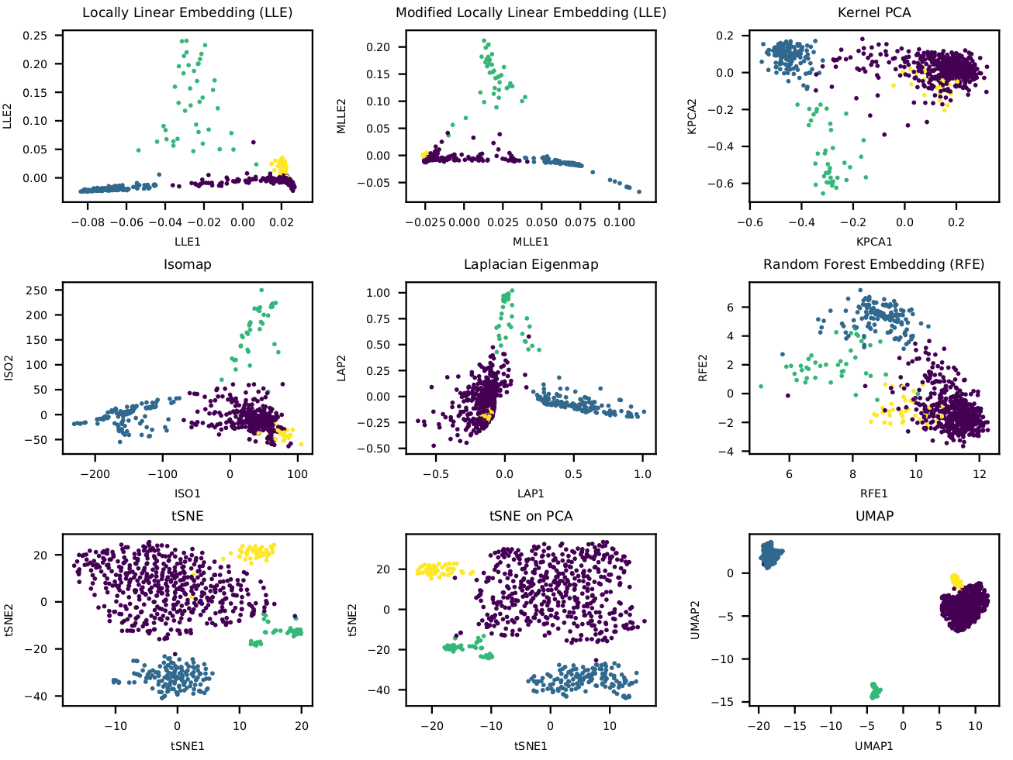
Non-linear dimensionality reduction
M. Bartoschek, N. Oskolkov et al.,
Nature Communications 2018

Slide 7
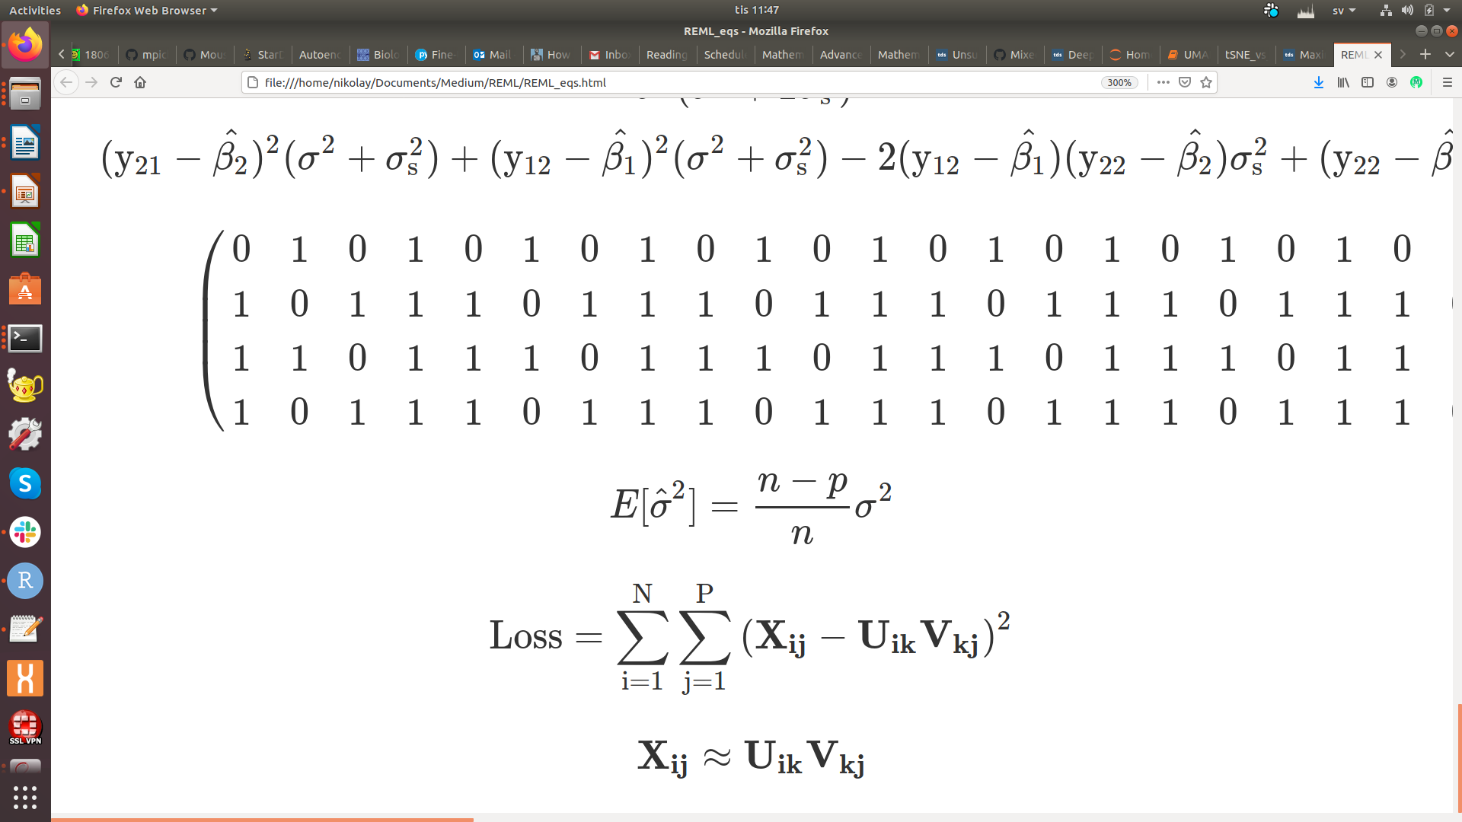
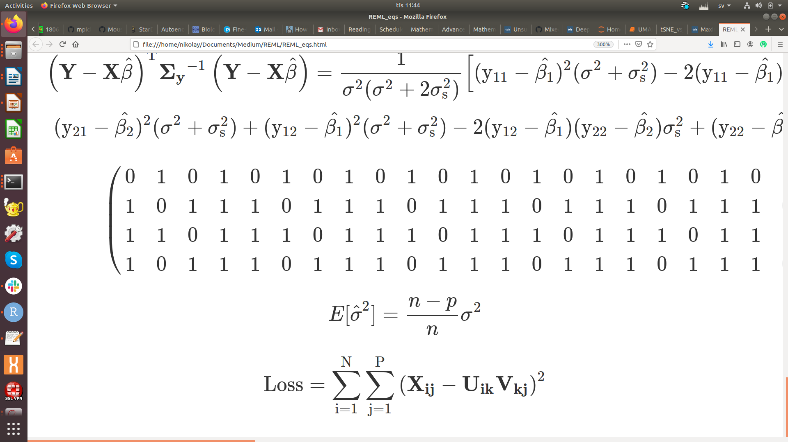
Linear dimension reduction: matrix factorization
P
D
P
x
V_{kj}
D
N
X_{ij}
≈
N
U_{ik}
Loadings
Data
Low-dimensional
data representation
(embeddings)

Slide 8
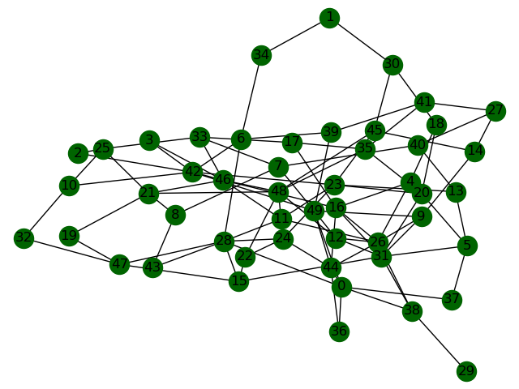
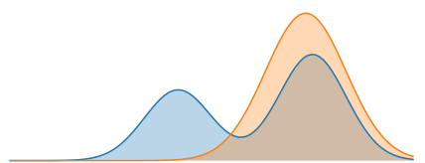
Non-linear dimension reduction: neighborhood graph
1) Construct high-dimensional graph
p_{ij}
3) Collapse the graphs together
q_{ij}
p_{ij}
Kullback-Leibler divergence
2) Construct low-dimensional graph
q_{ij}

Slide 9
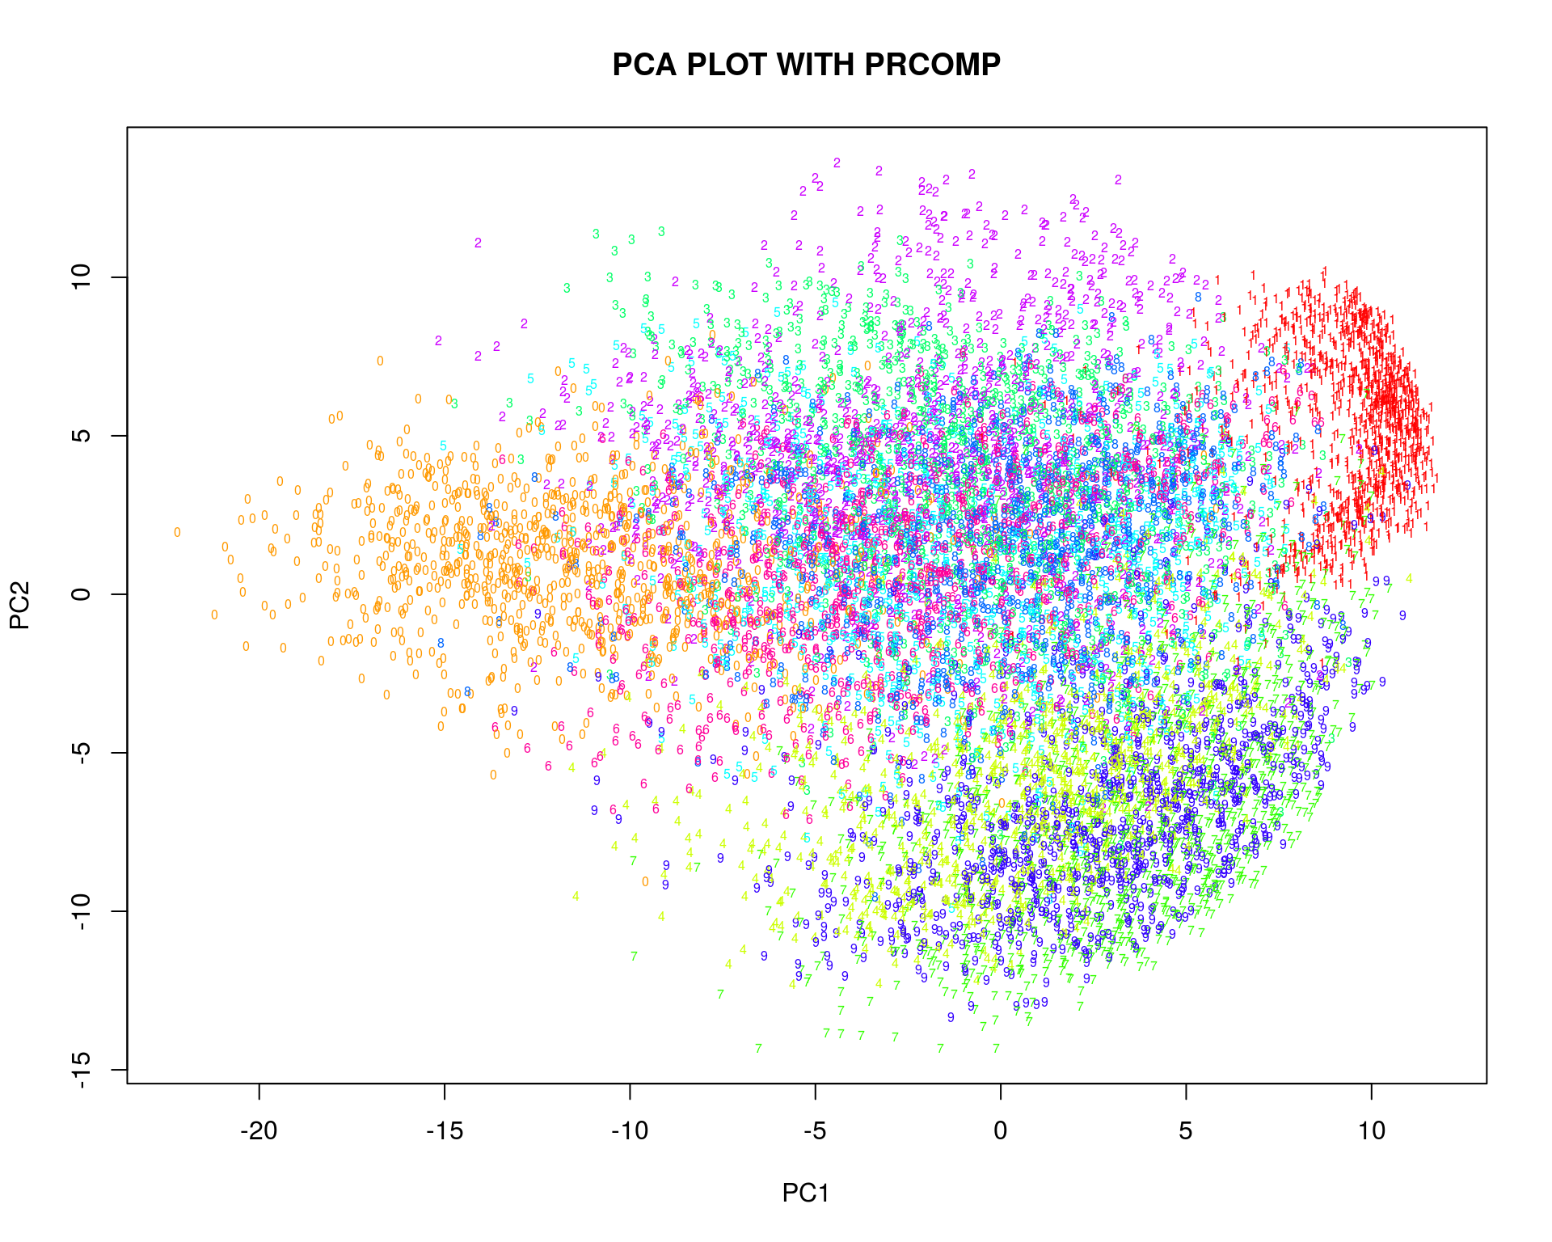
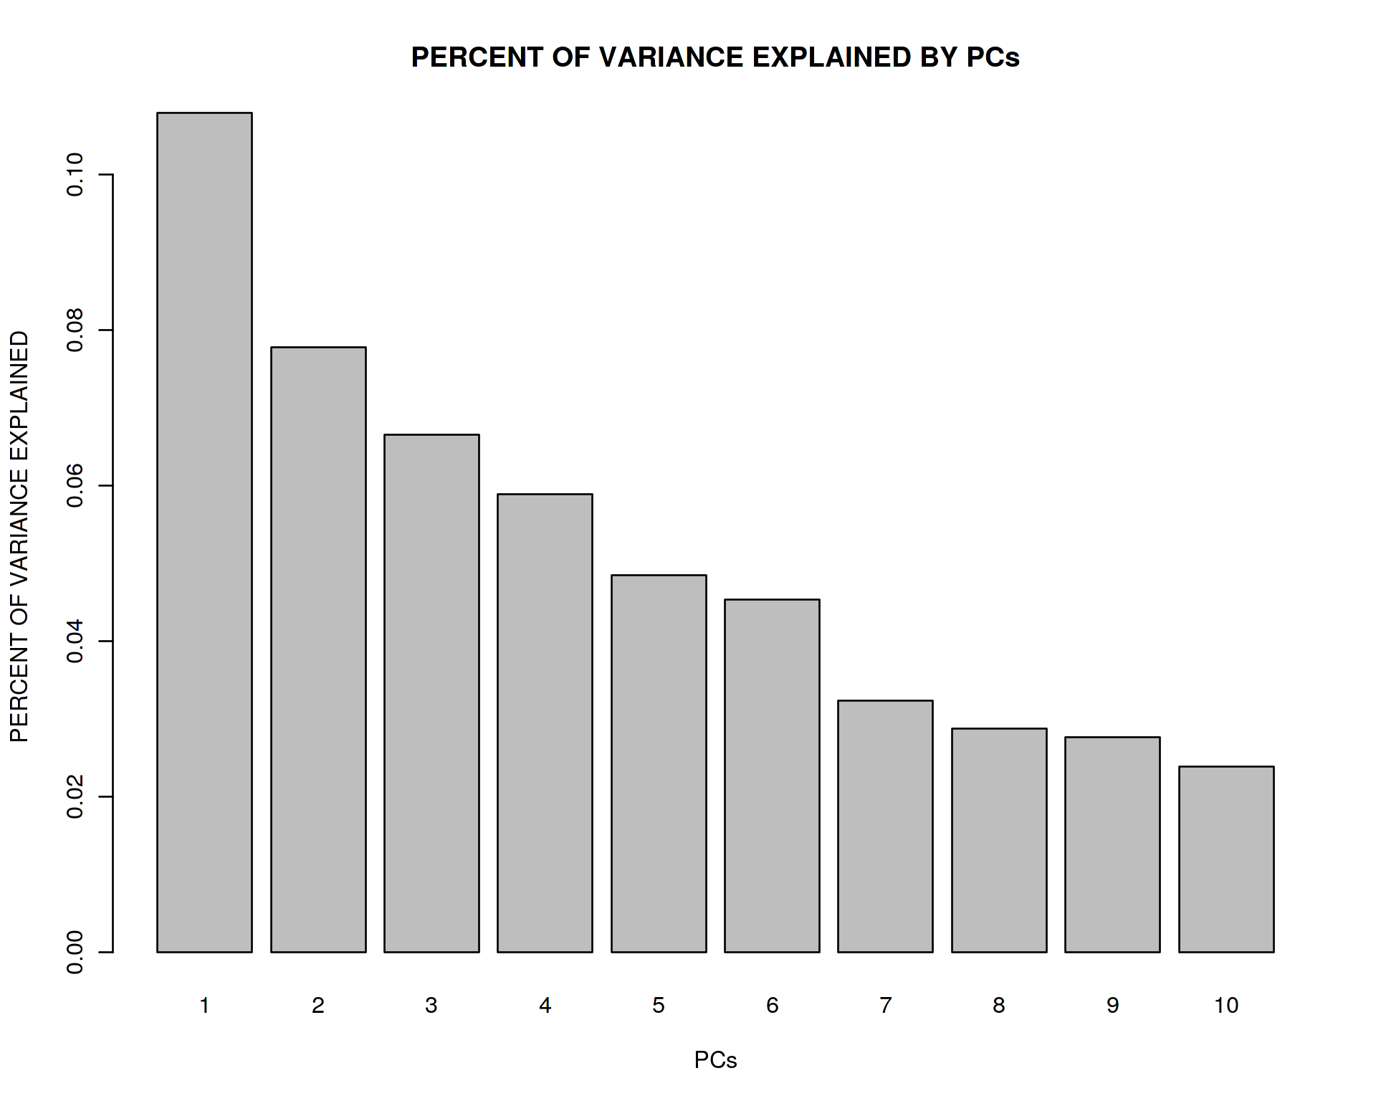
PCA dimension reduction algorithm
Coding in R:
Mathematically:
data_centered <- scale(data, center = TRUE, scale = FALSE)
covariance <- t(data_centered) %*% data_centered
eig <- eigen(covariance)
plot(eig$vectors[,1:2]); barplot(eig$values / sum(eig$values))
M_{ij} = X_{ij} – μ_{j}
A = (1/N)*M^{T}*M
A*u = λ*u
It can be analytically derived that the eigen value decomposition in PCA is equivalent to projecting data on axes of maximal variation in the data

Slide 10
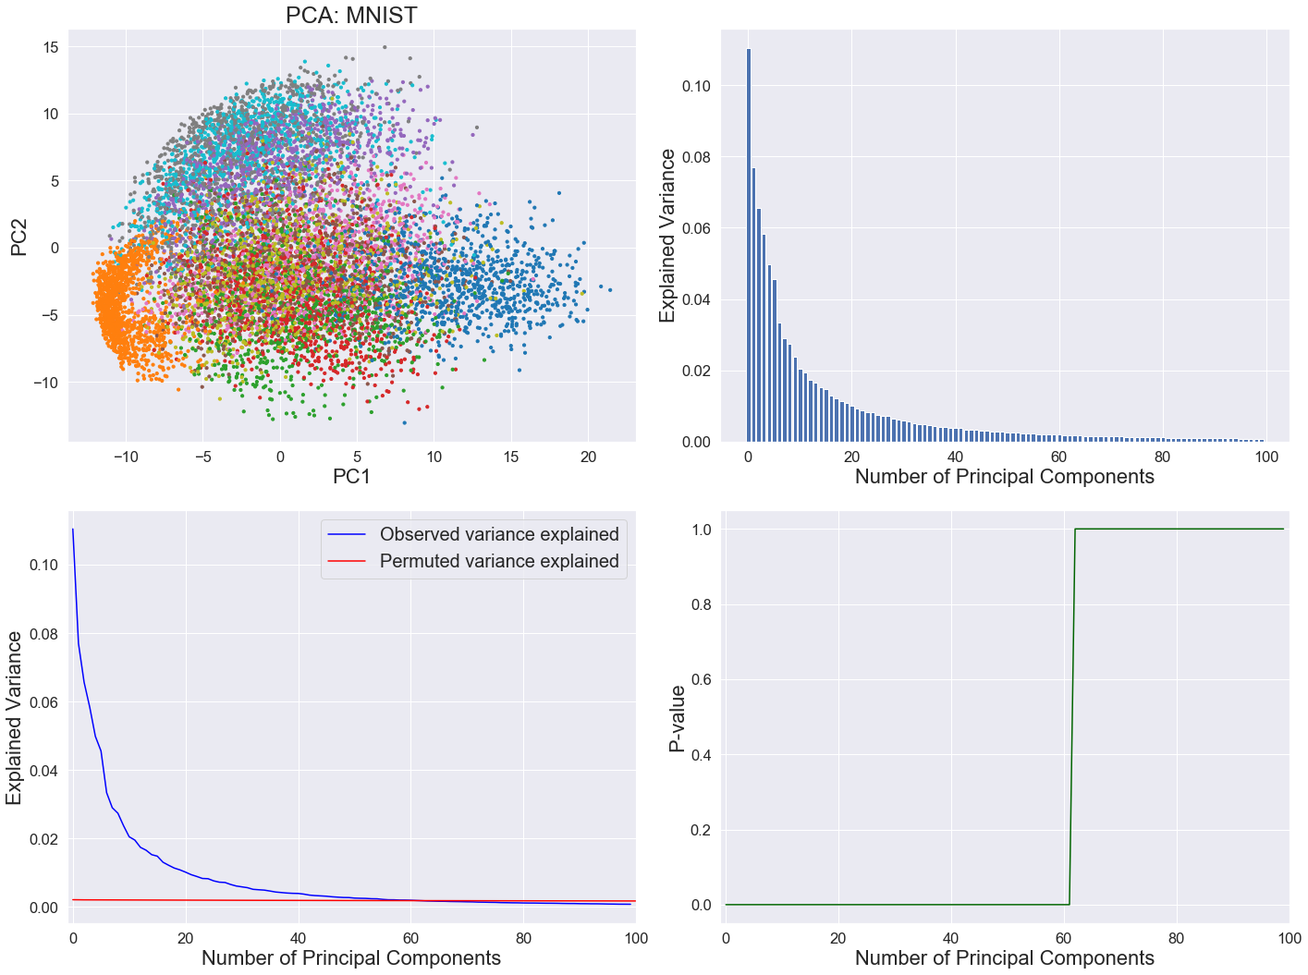
Estimating the number of informative PCs
In Seurat: JackStraw
Tracy-Widom approach

Slide 11
When linear dimension reduction is not good enough

Slide 12
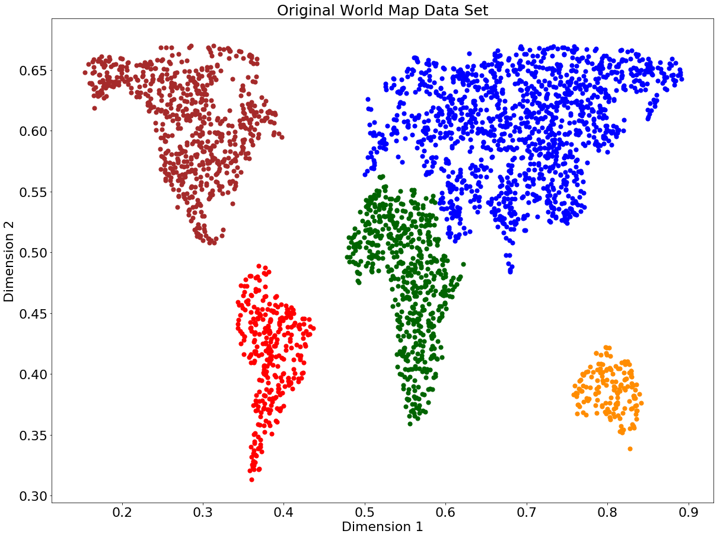
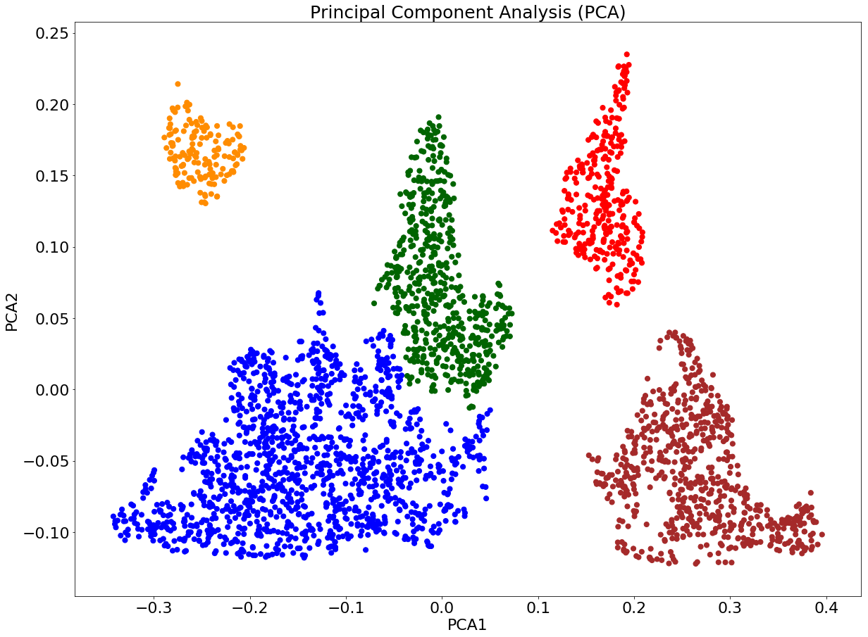
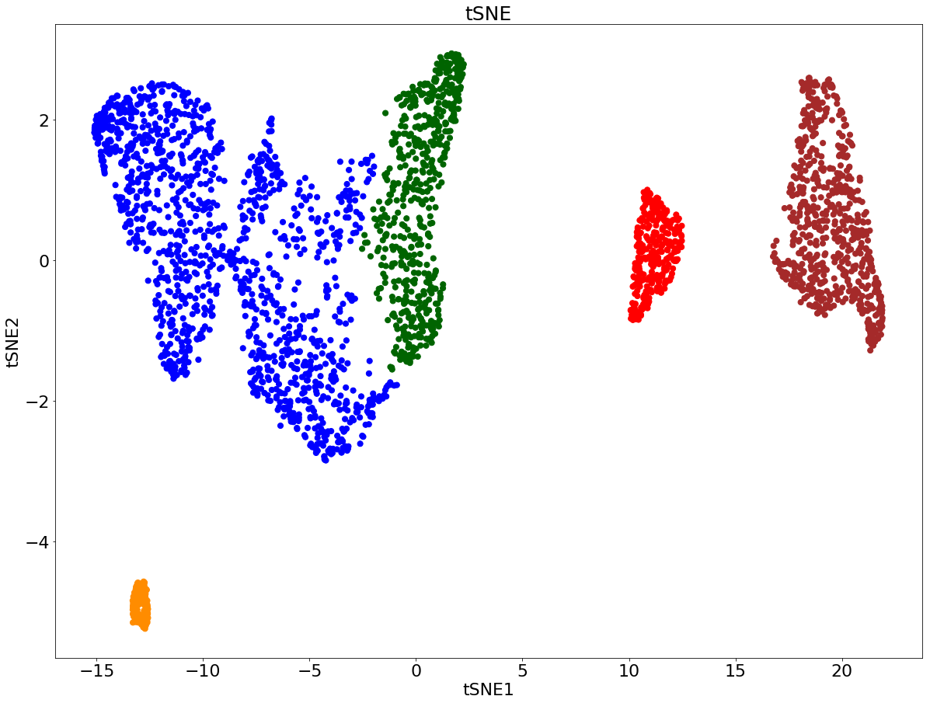
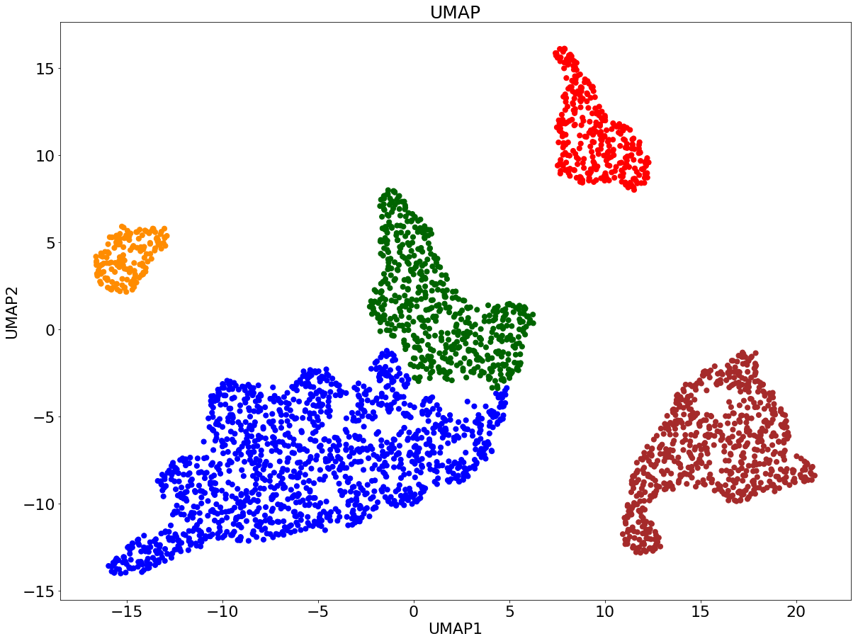
PCA works fine on a linear manifold

Slide 13
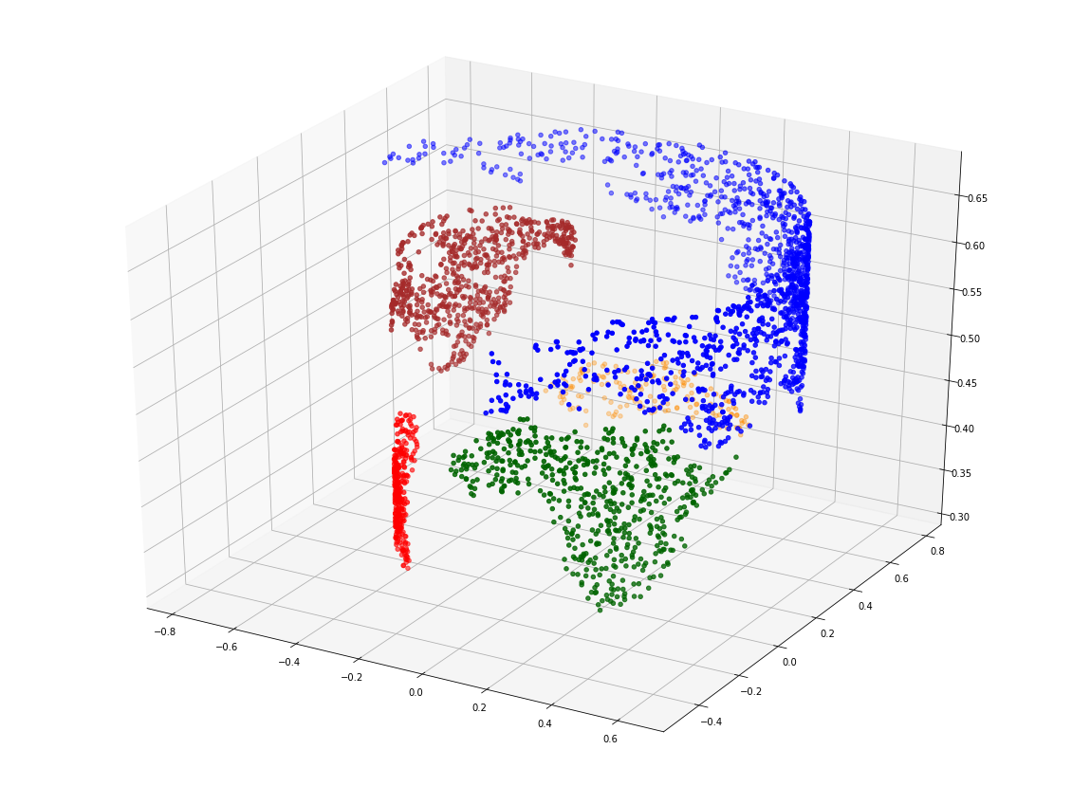
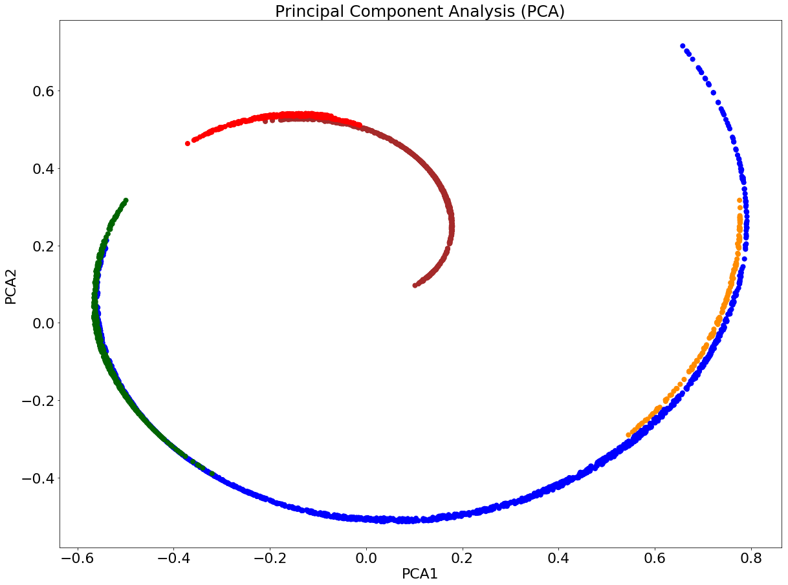
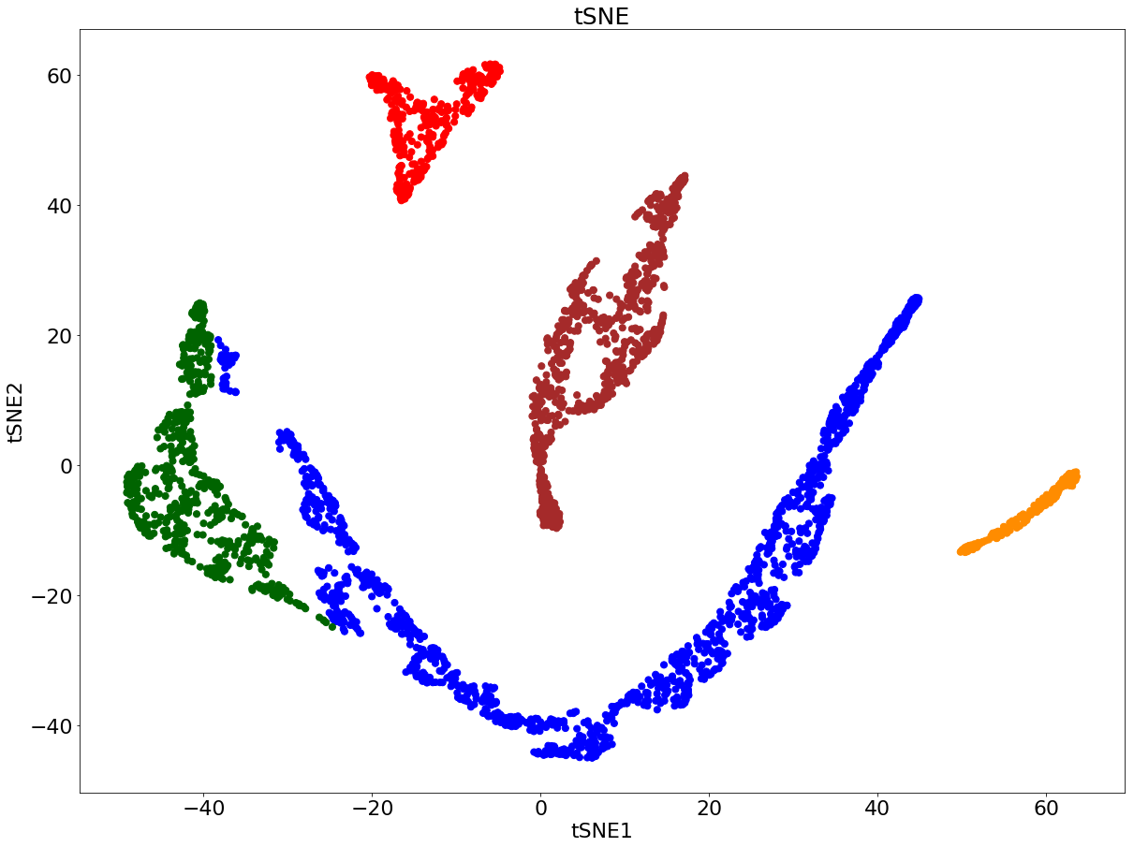
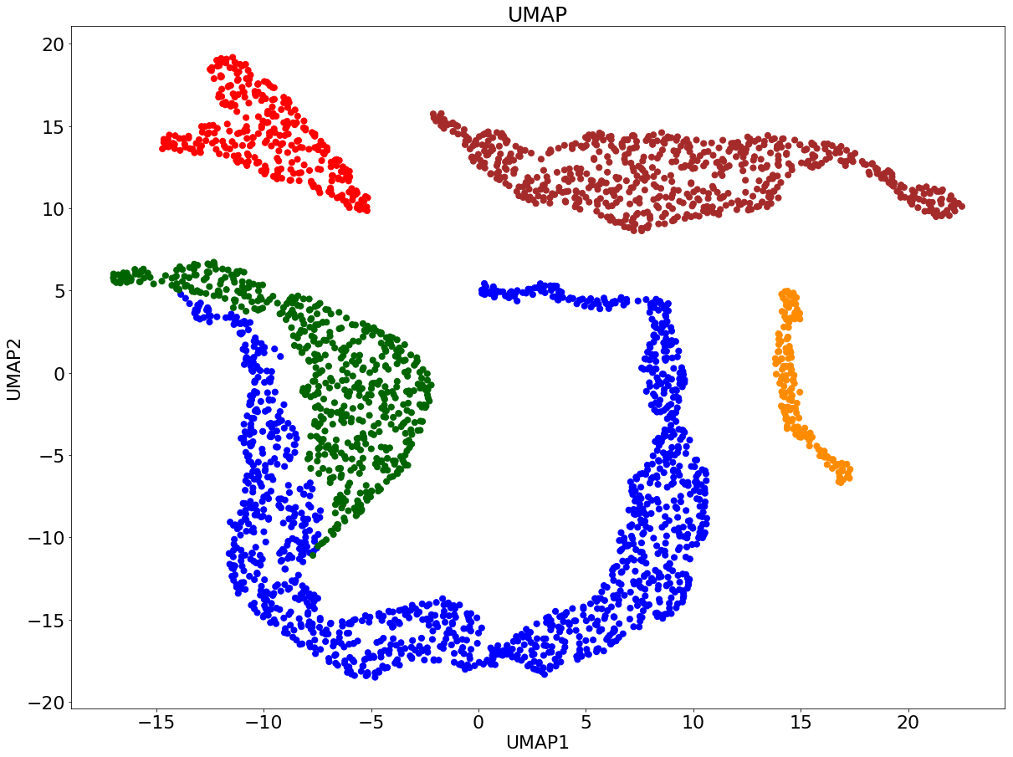
PCA vs. tSNE vs. UMAP on non-linear manifold

Slide 14
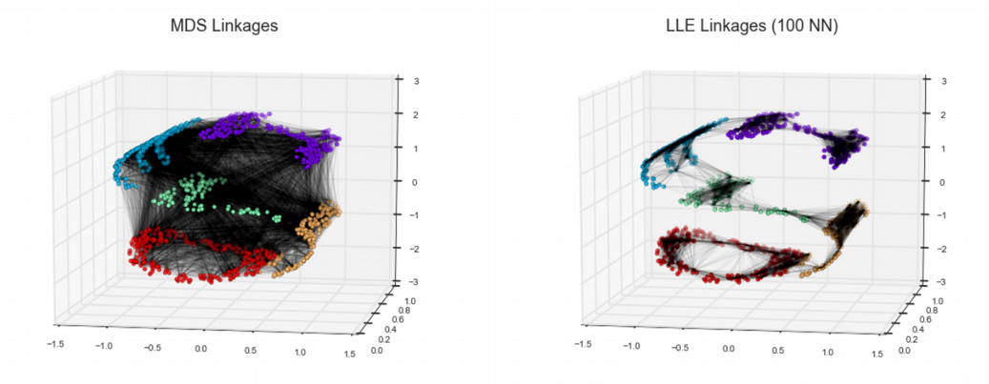
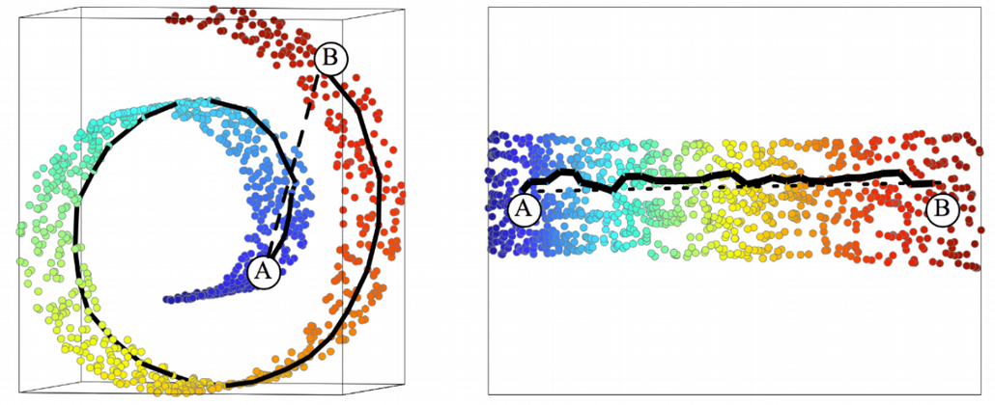
Why PCA can’t unwrap the Swiss Roll

Slide 15
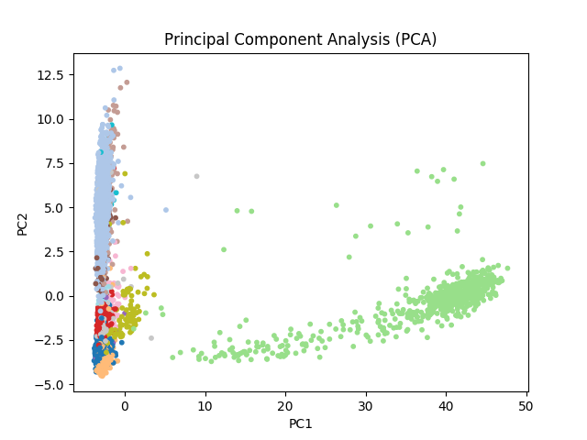
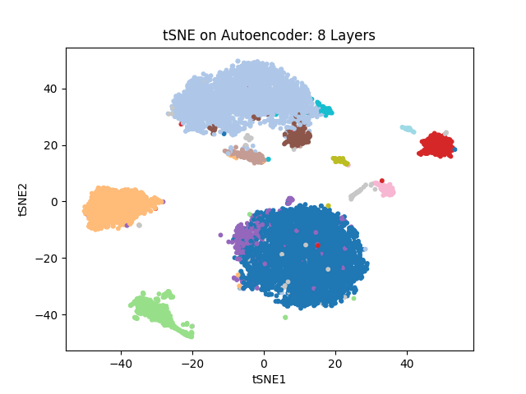
Why PCA is not enough in Single Cell
3k Peripheral Blood Mononuclear Cells (PBMC) available from 10X Genomics
Two principal components (PCs) seem to be insufficient to fully reveal heterogeneity in single cell gene expression data.
Solution: use more PCs or tSNE / UMAP
https://satijalab.org/seurat/articles/pbmc3k_tutorial.html

Slide 16
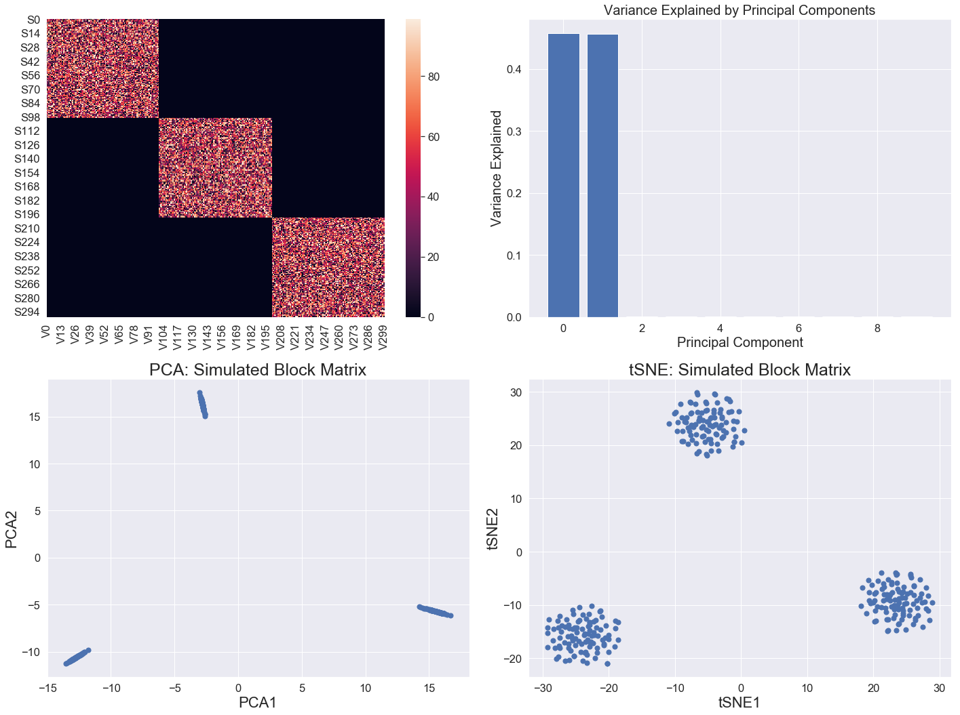
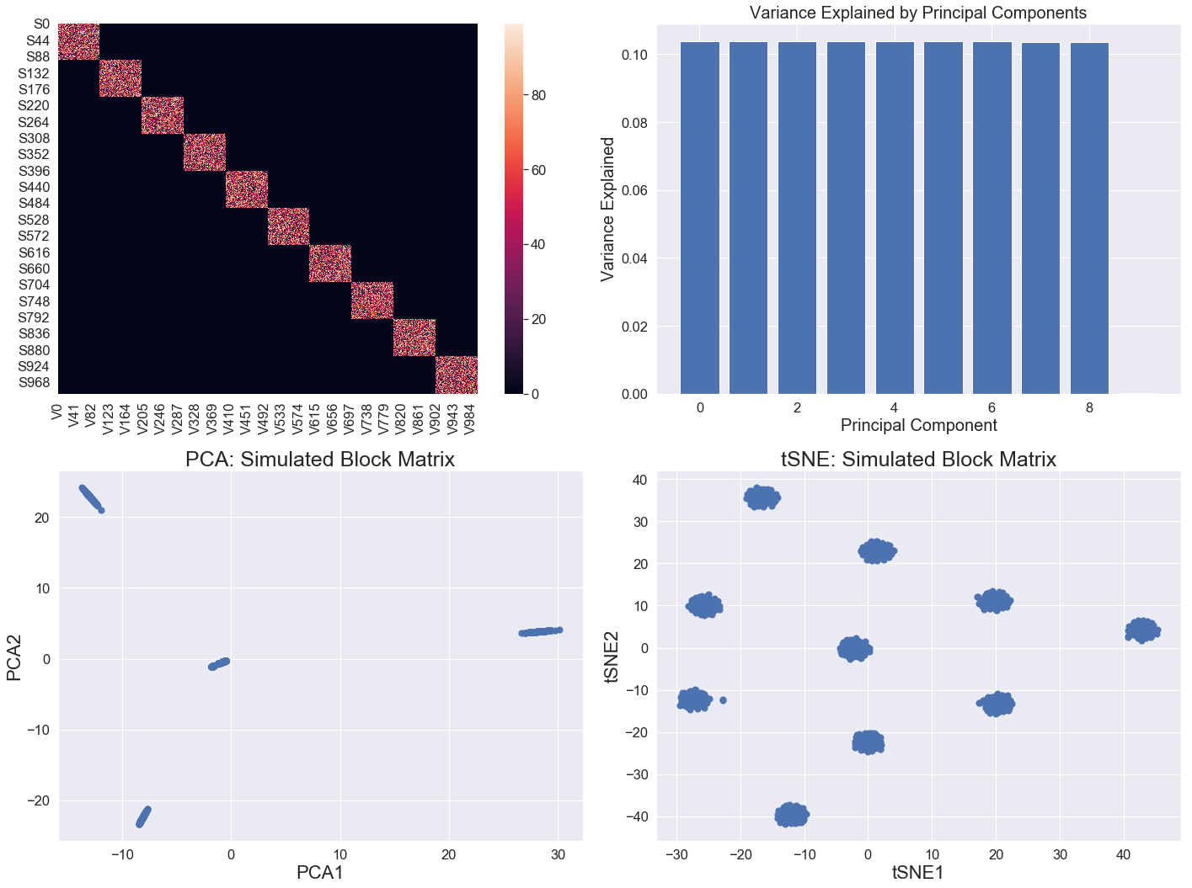
PCA vs. tSNE: when data complexity grows
Three classes of data points
Ten classes of data points
PCA and tSNE tell the same story
tSNE is more informative than PCA
Oskolkov et al., unpublished

Slide 17
Neighborhood graph dimension reduction: tSNE and UMAP

Slide 18
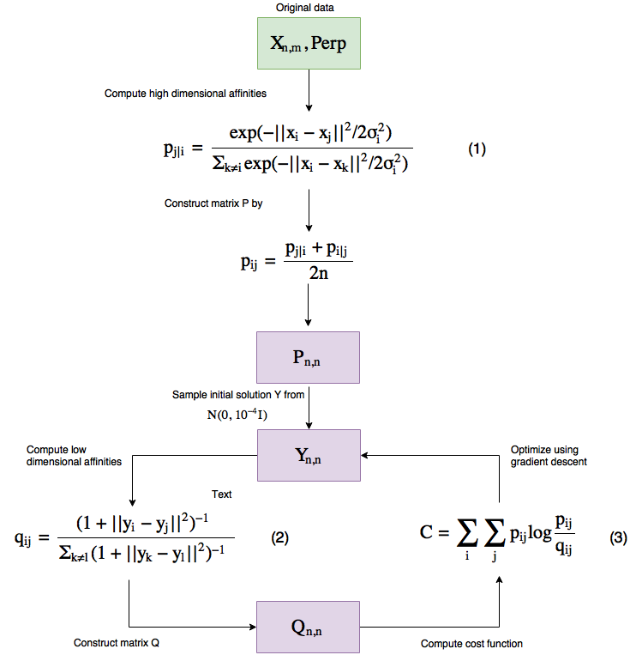
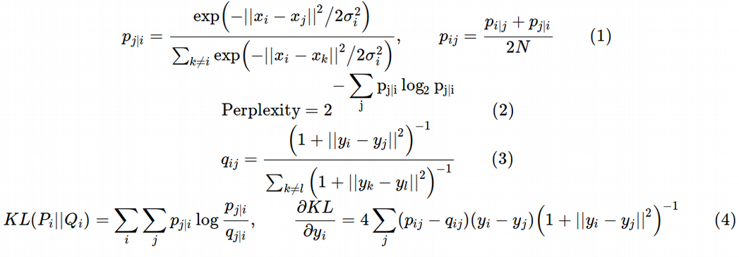
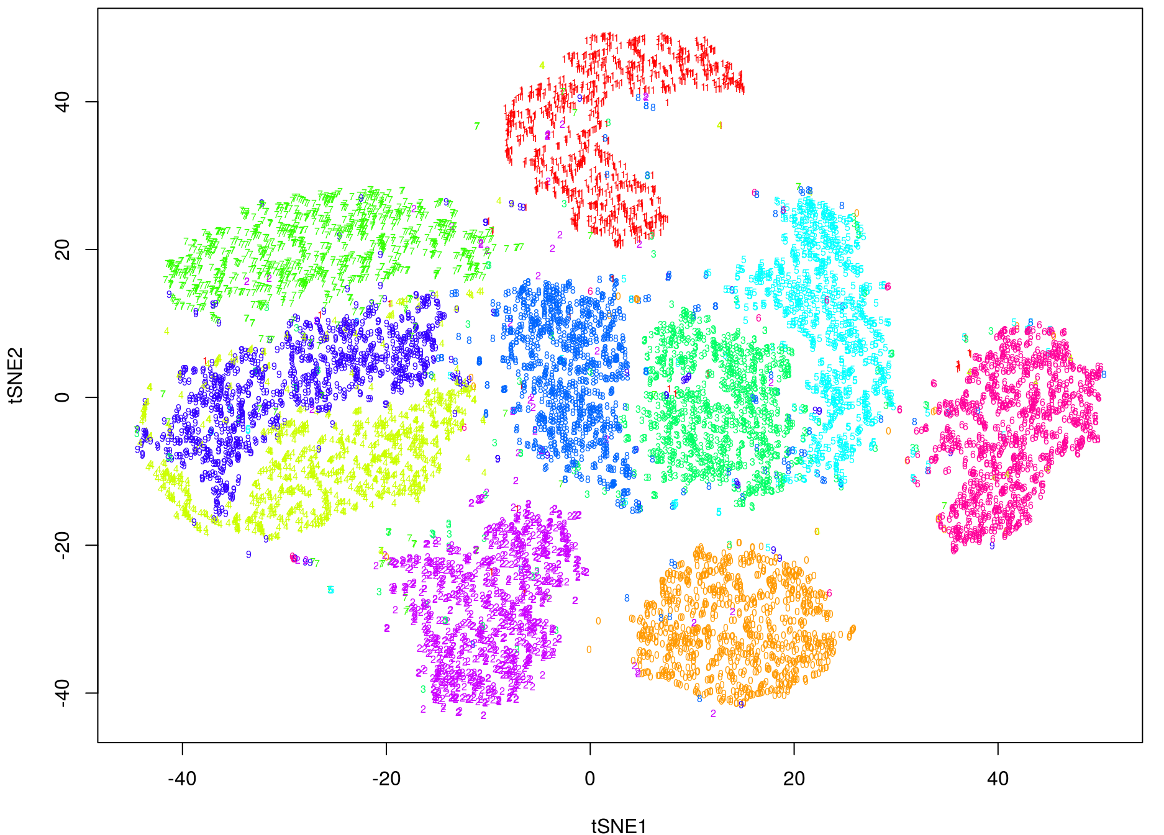
tSNE dimension reduction algorithm

Slide 19
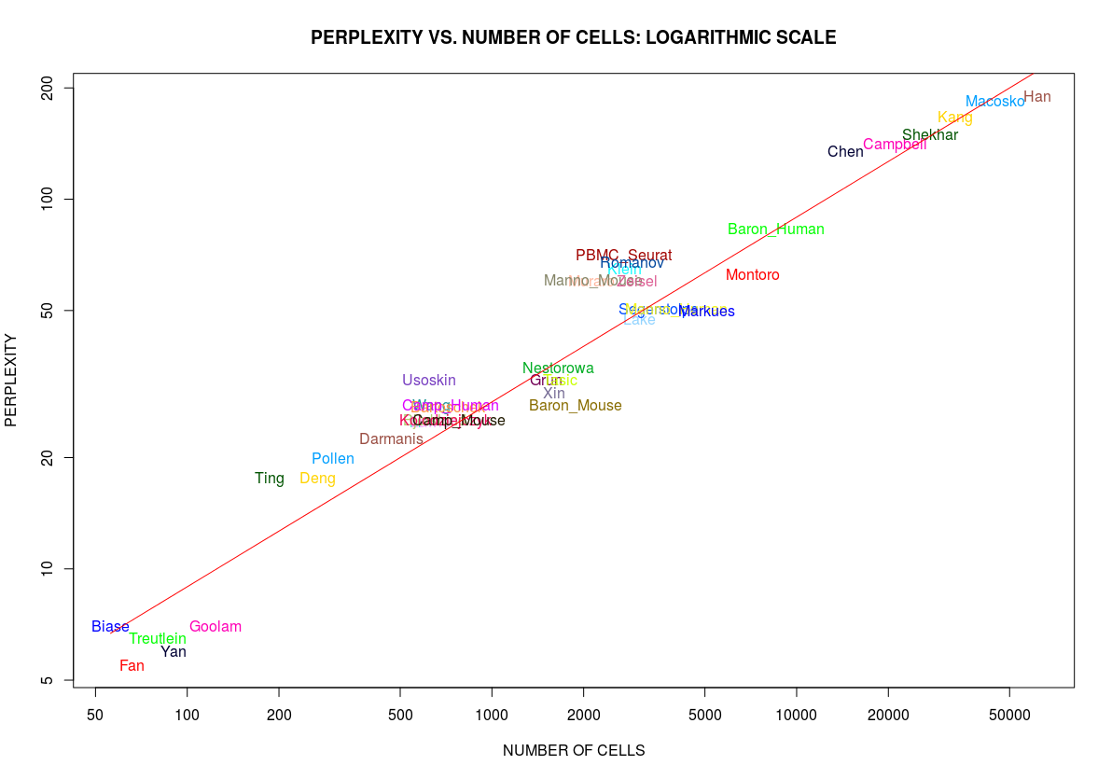
How to select optimal perplexity
Van der Maaten: “Loosely speaking, one could say that a larger / denser dataset requires a larger perplexity.“
log(Perp) = -0.179 + 0.51*log(N)
Perp ~ N^(1/2)

Slide 20
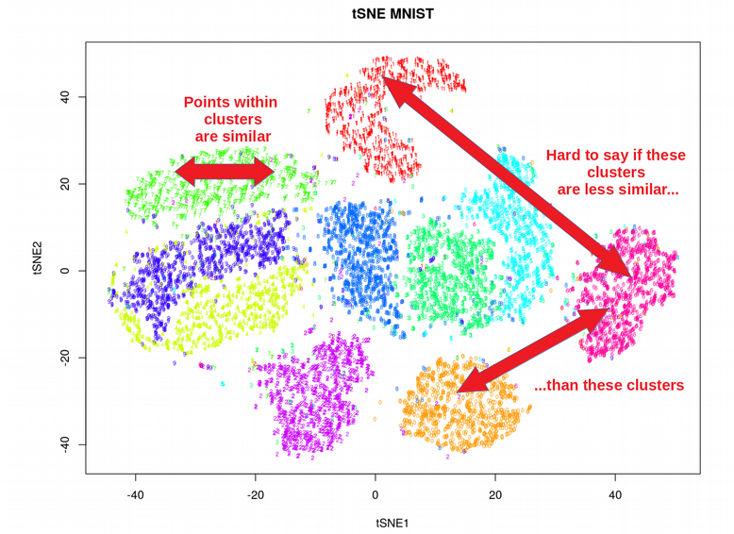
Limitations of tSNE and promise of UMAP
tSNE does not scale for large data sets?
tSNE does not preserve global structure?
tSNE can only embed into 2-3 dims?
tSNE performs non-parametric mapping (no variance explained statistics)?
tSNE can not work with high-dimensional
data directly (PCA needed)?
tSNE uses too much RAM at large perp?

Slide 21
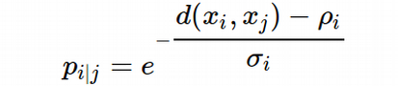
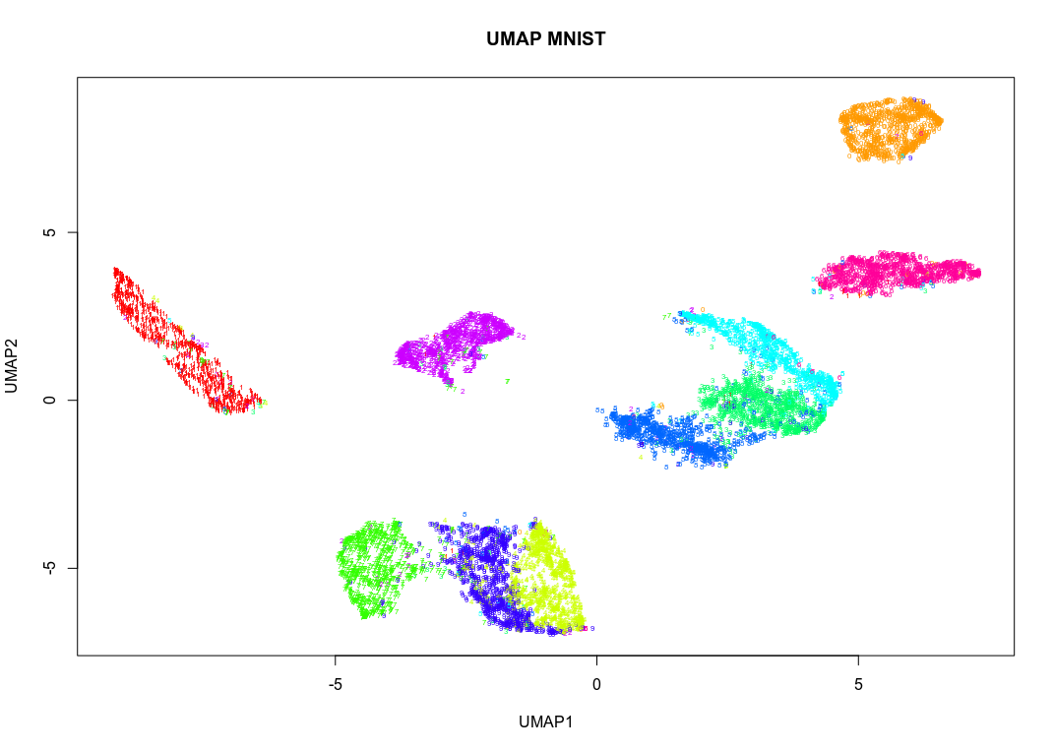
How is UMAP different from tSNE
UMAP uses local connectivity for high-dim probabilities
UMAP does not normalize probabilities (speed-up)
UMAP can deliver a number of components for clustering
UMAP uses Laplacian Eigenmap for initialization
UMAP uses Cross-Entropy (not KL) as cost function
This is similar to tSNE cost function
This term is UMAP specific

Slide 22
tSNE vs. UMAP: global structure preservation

Slide 23
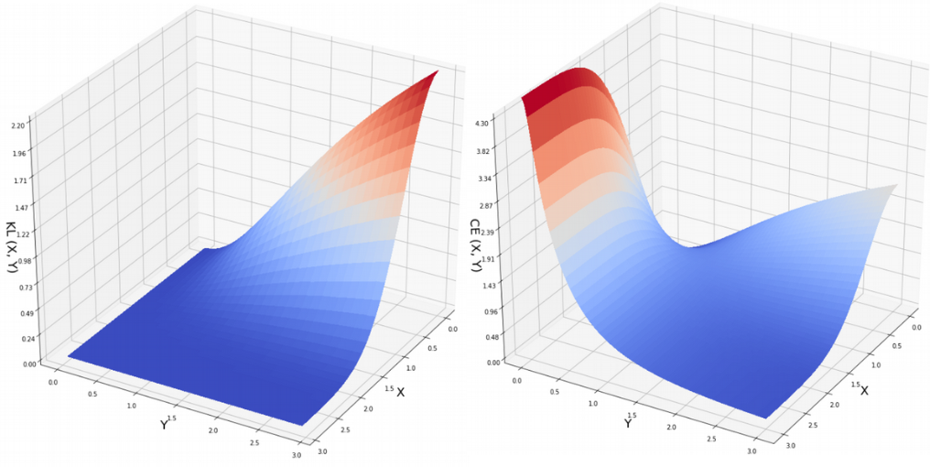
Cost function seems to make UMAP
preserve more of global structure than tSNE
X → infinity, Y can be any
X → infinity, Y → infinity

Slide 24
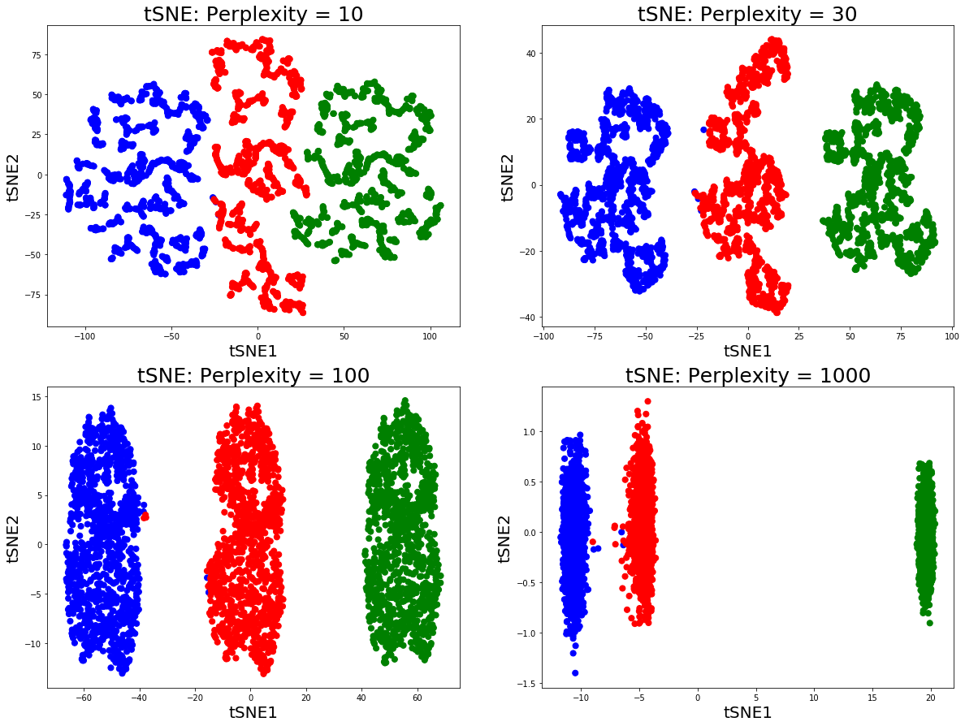
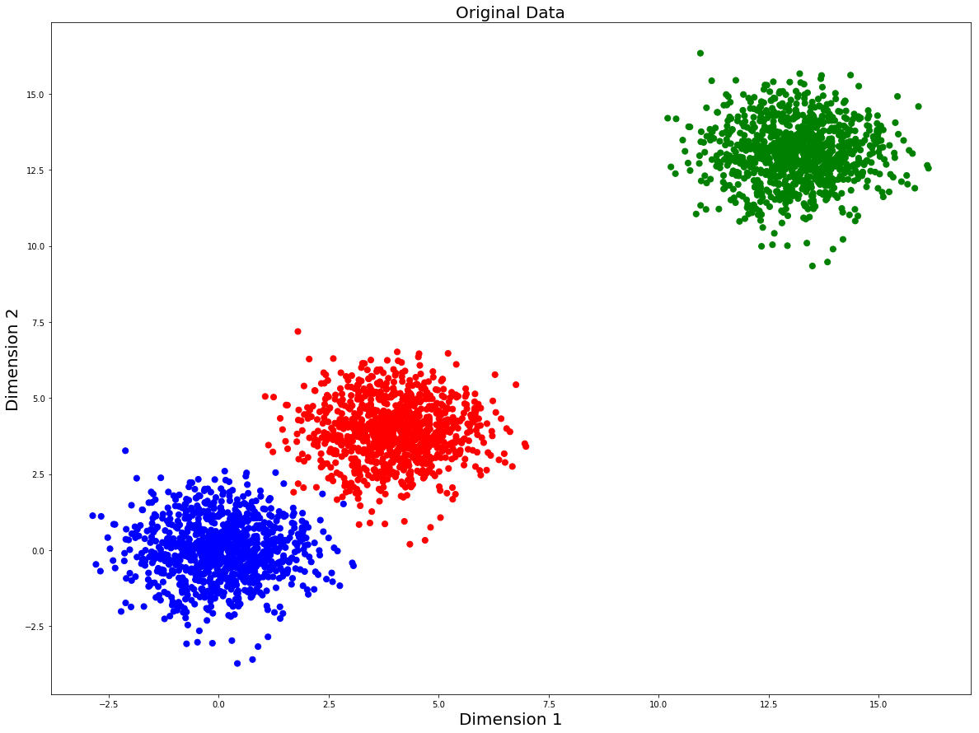
Why preserving global structure is important
Can large perplexity solve the problem of global structure for tSNE?

Slide 25
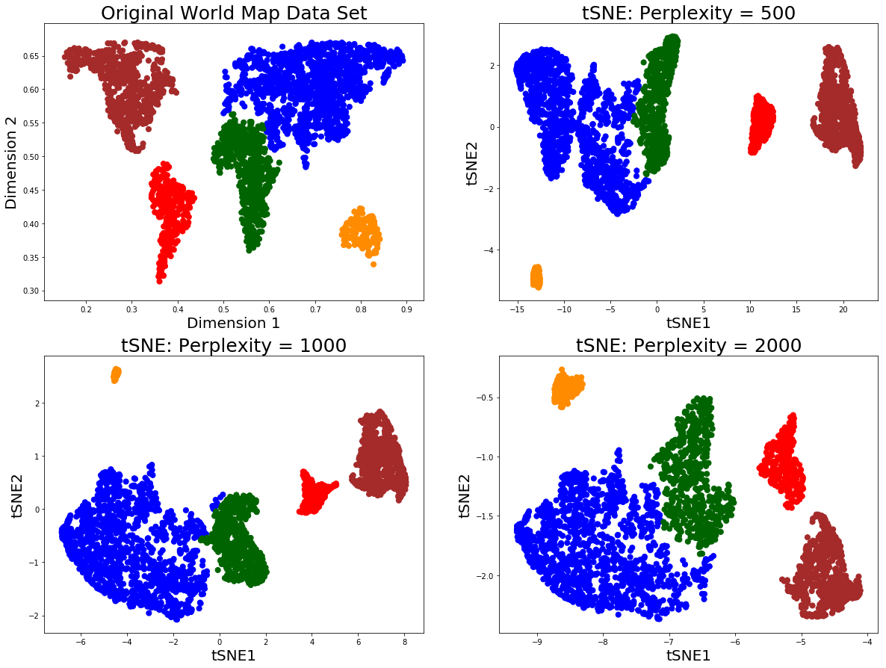
Why preserving global structure is important
Can large perplexity solve the problem of global structure for tSNE?

Slide 26
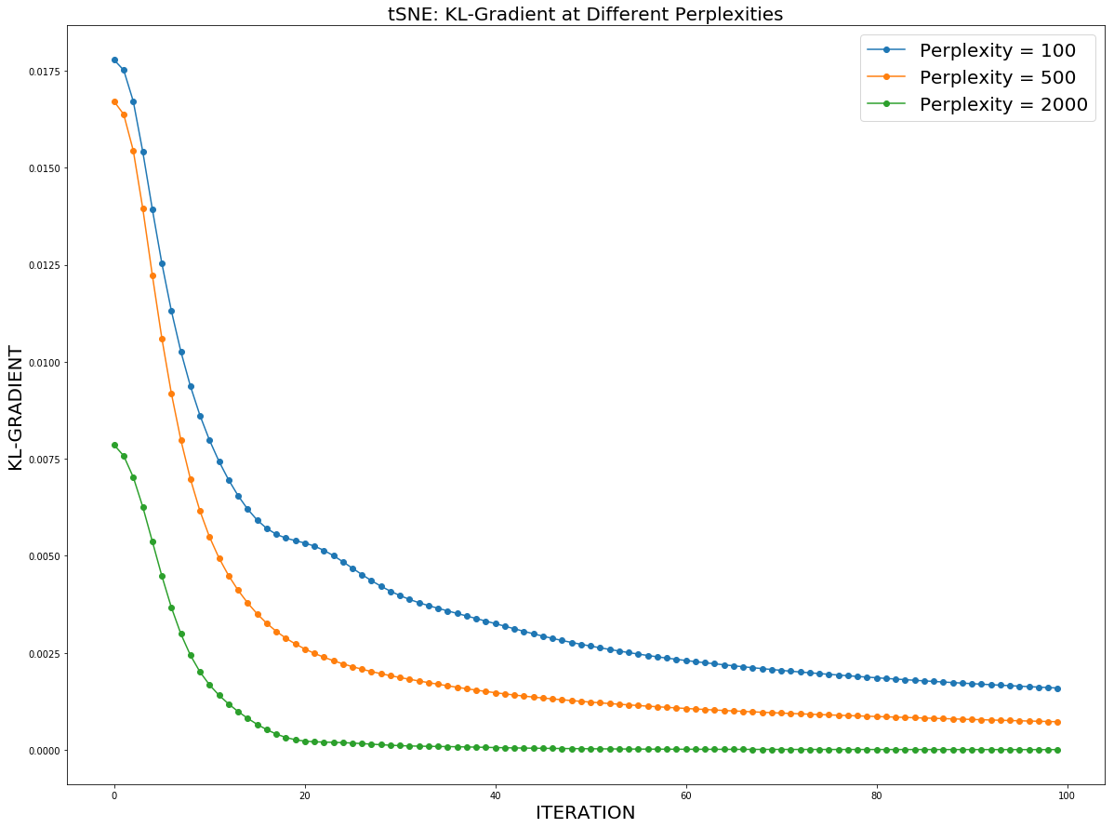
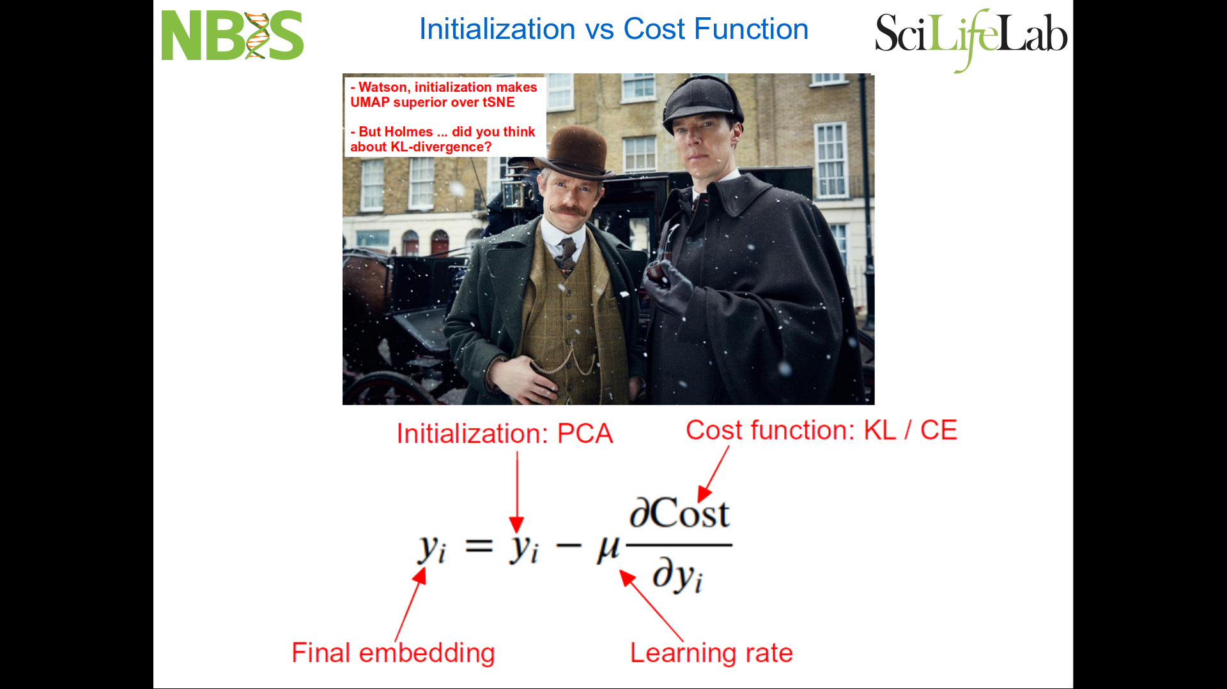
KL-gradient goes to zero at large perplexity

Slide 27
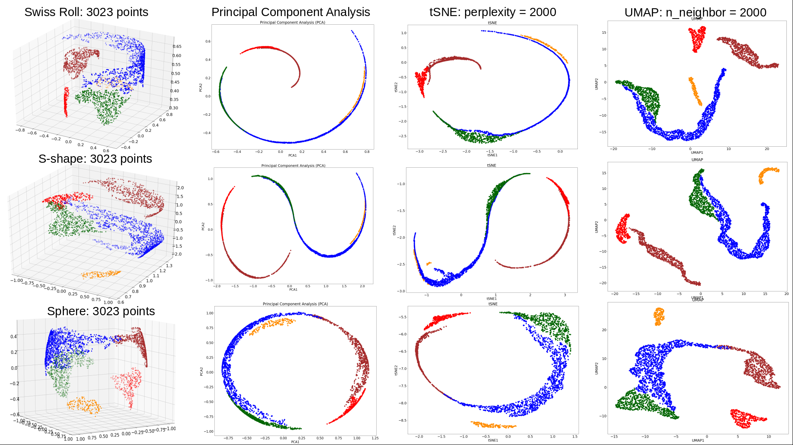
tSNE degrades to PCA on non-linear manifold at large perplexity

Slide 28
UMAP for Population Genomics applications:
addressing some recent fair and unfair criticism

Slide 29
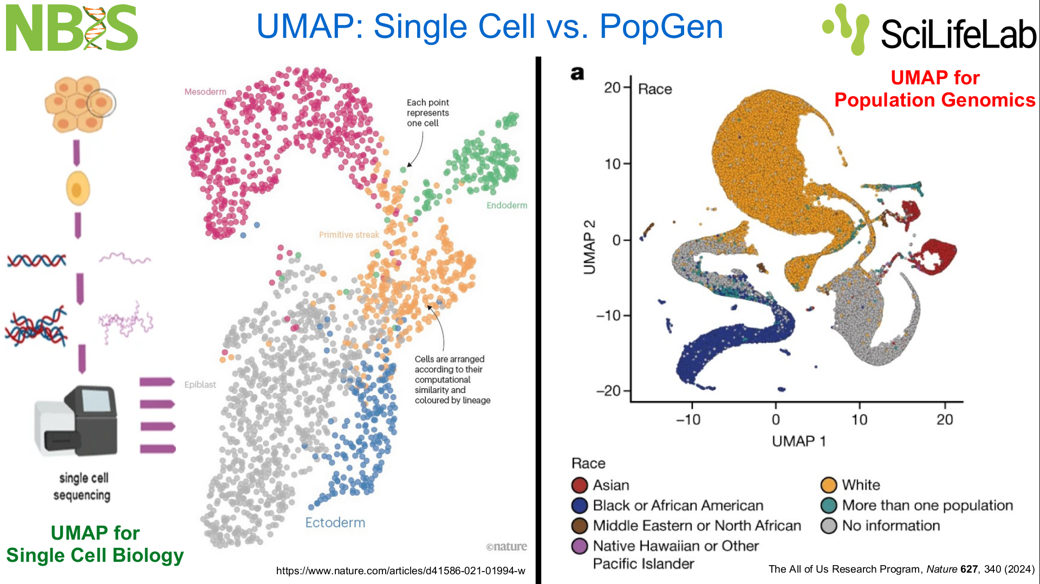

Slide 30
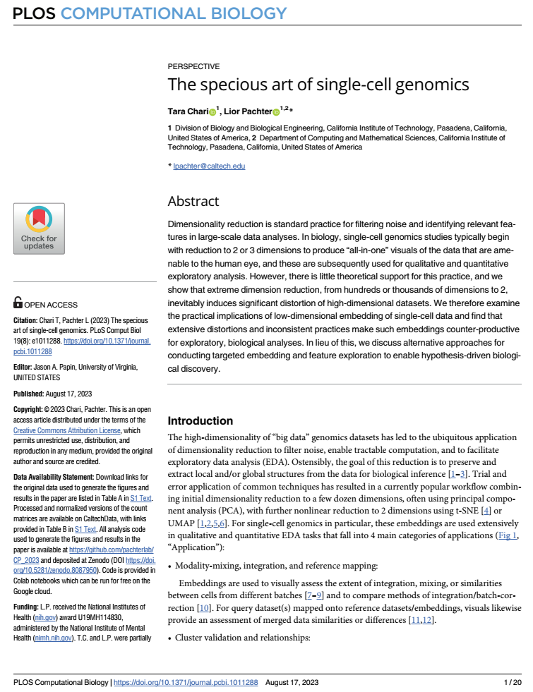
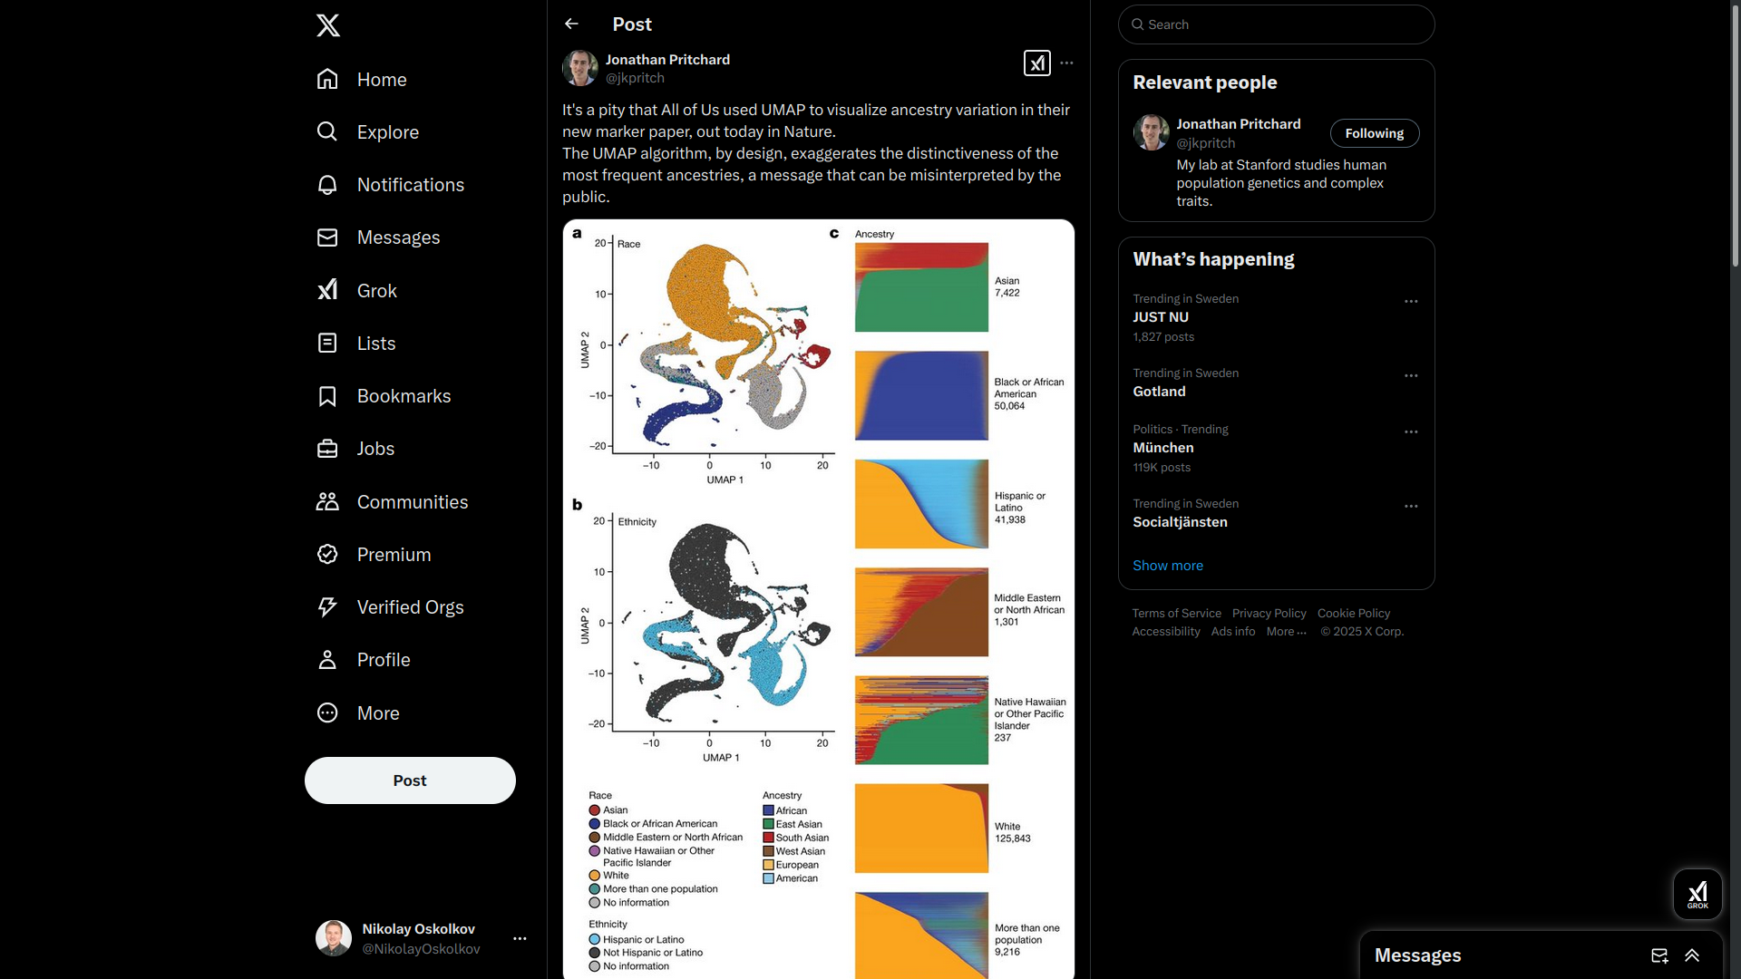



UMAP (and Single Cell) Criticism

Slide 31
Going through the post of Rafael Irizarry: Point1: UMAP makes artificial clusters!

Slide 32
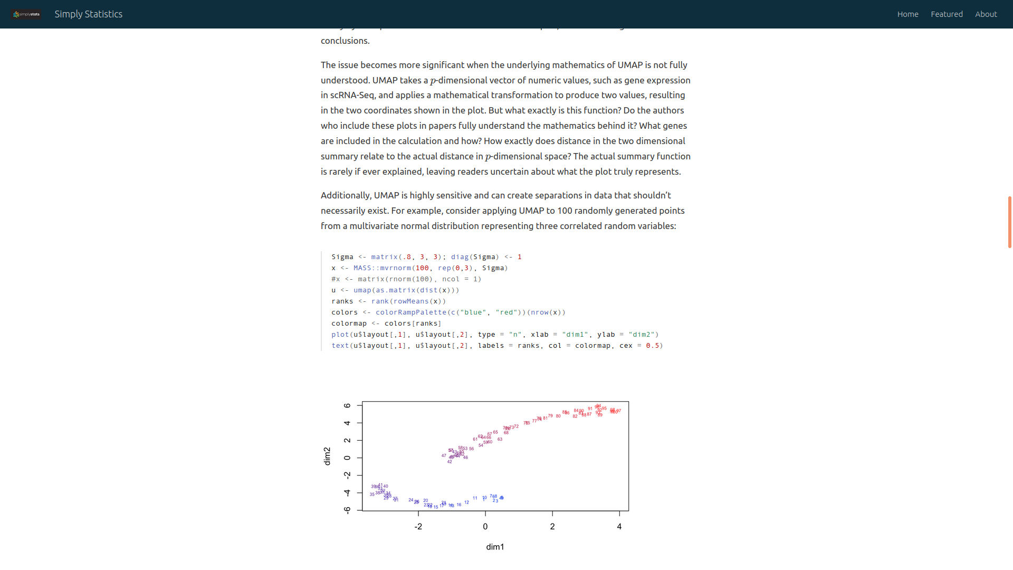
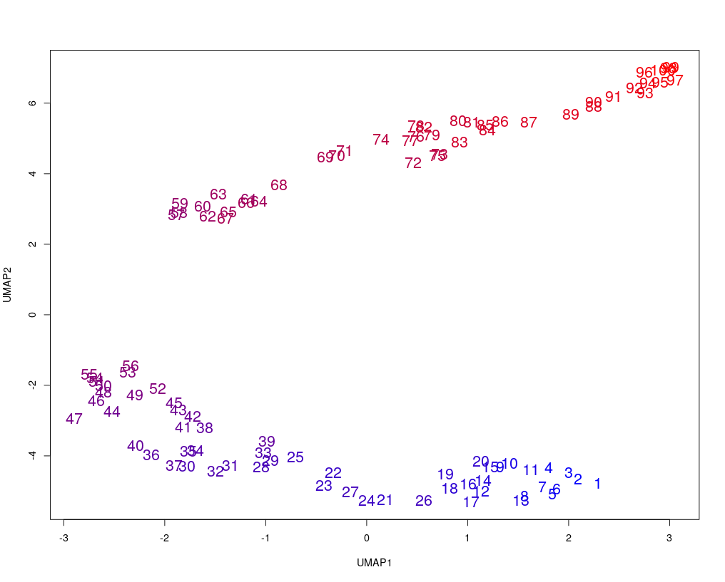
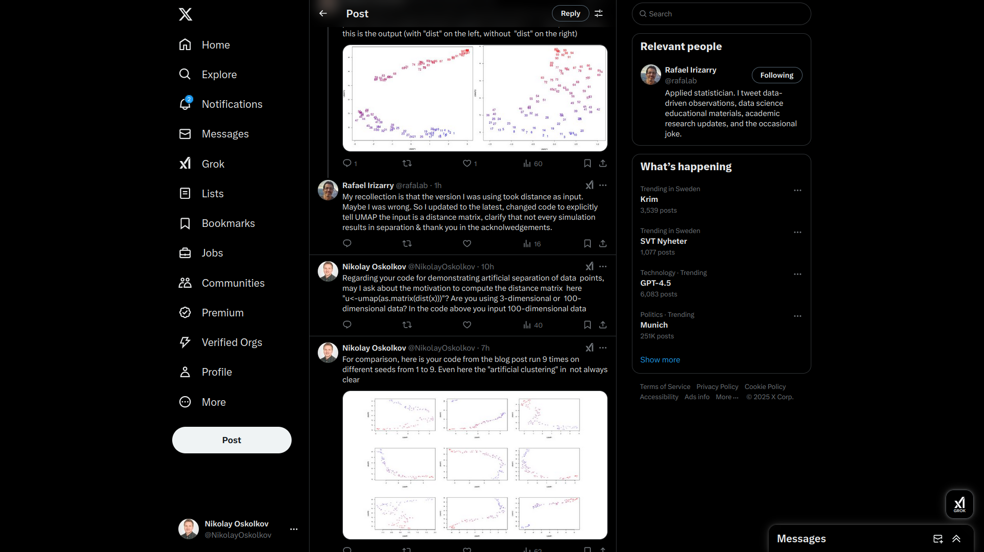
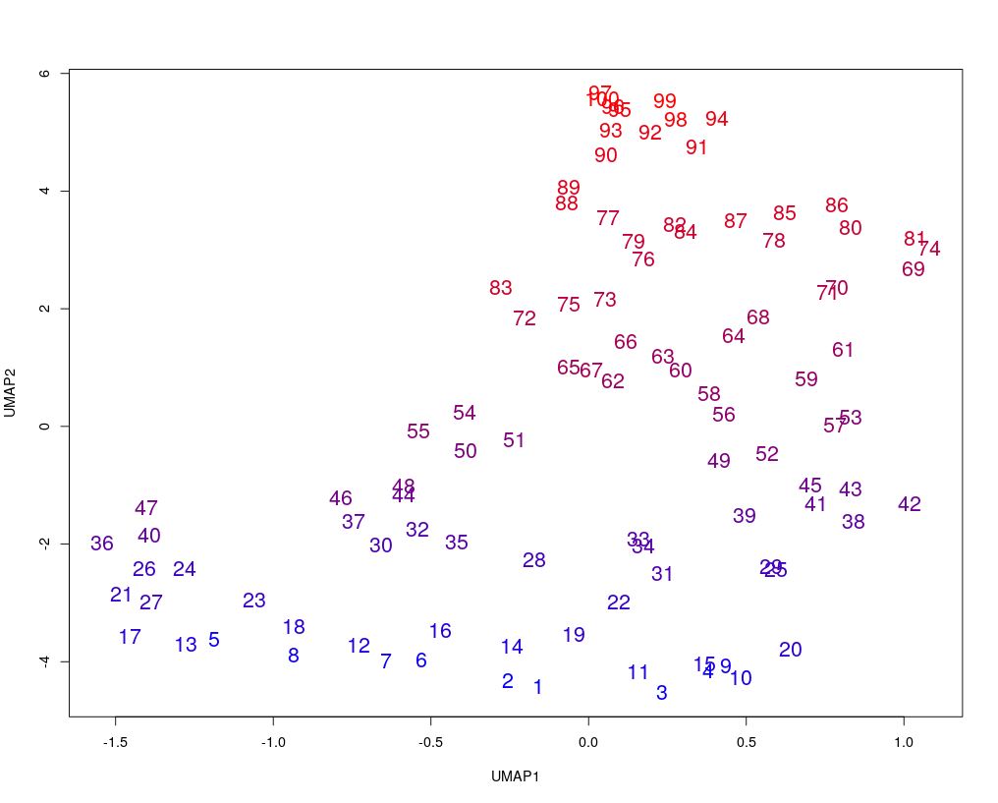
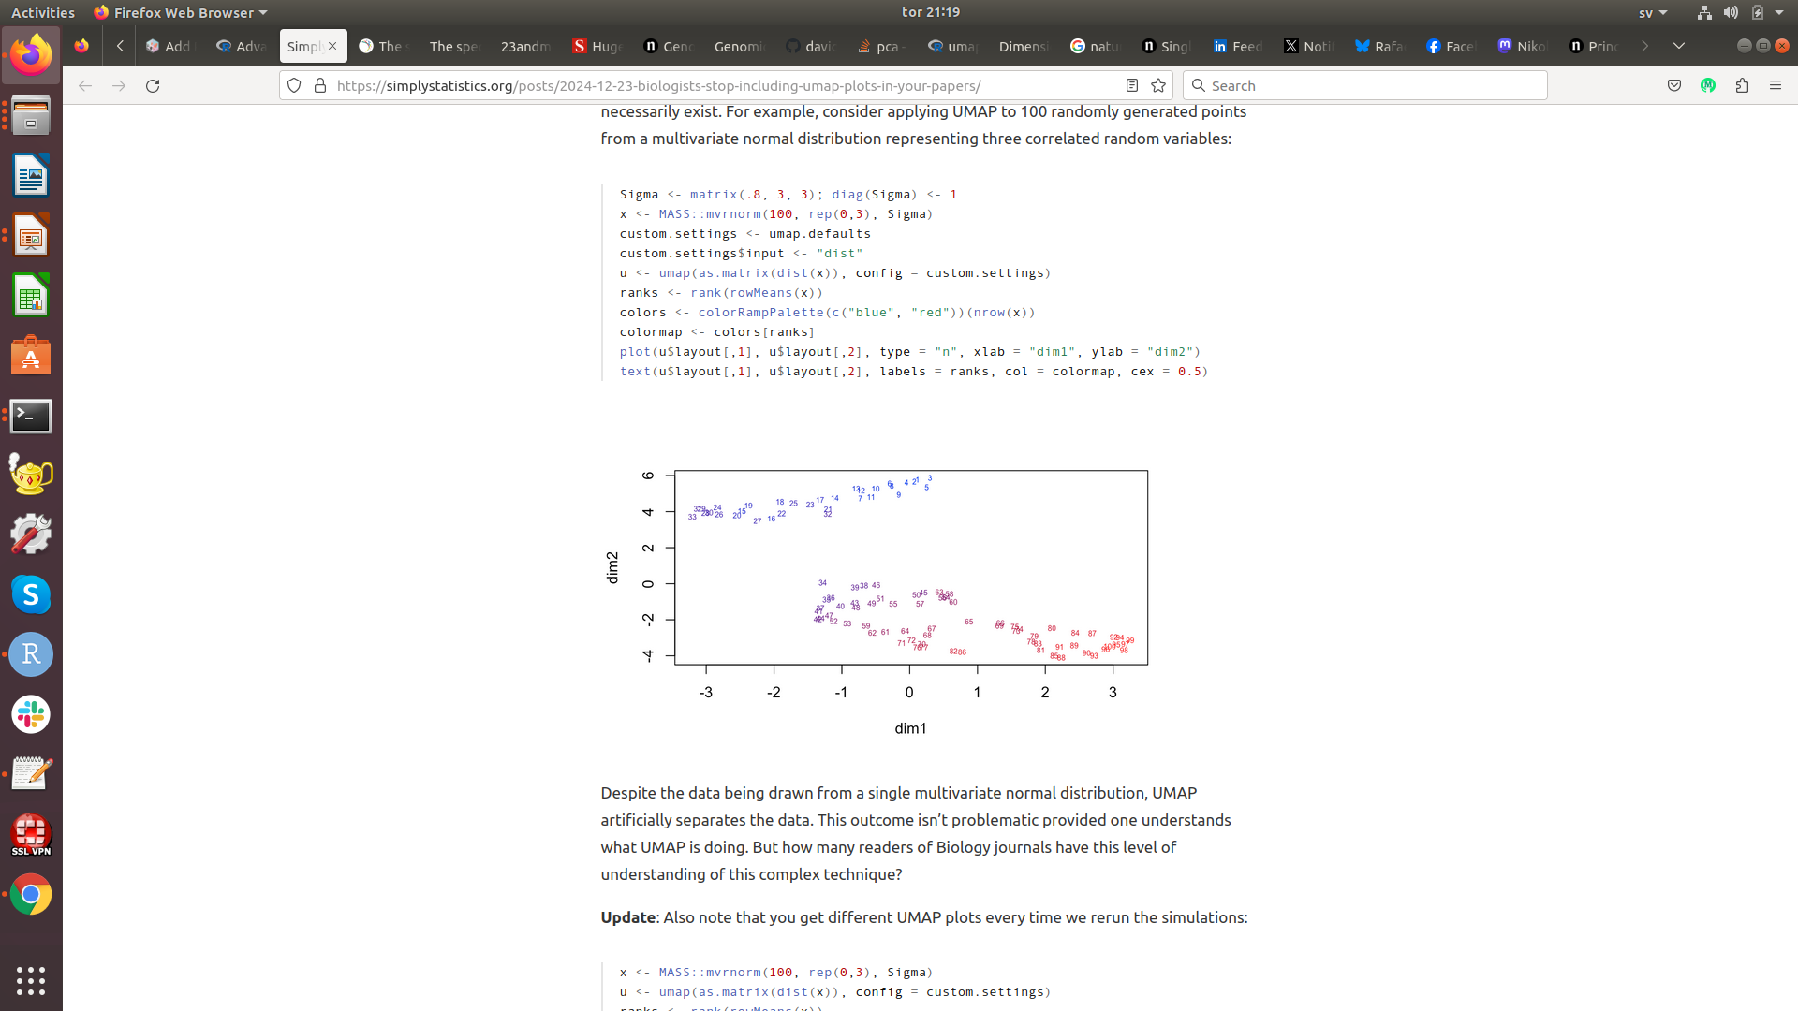
Are we looking at 3- or 100-dimensional data?
My experiment: UMAP on matrix of pairwise distances
My experiment: UMAP on raw
data matrix

Slide 33
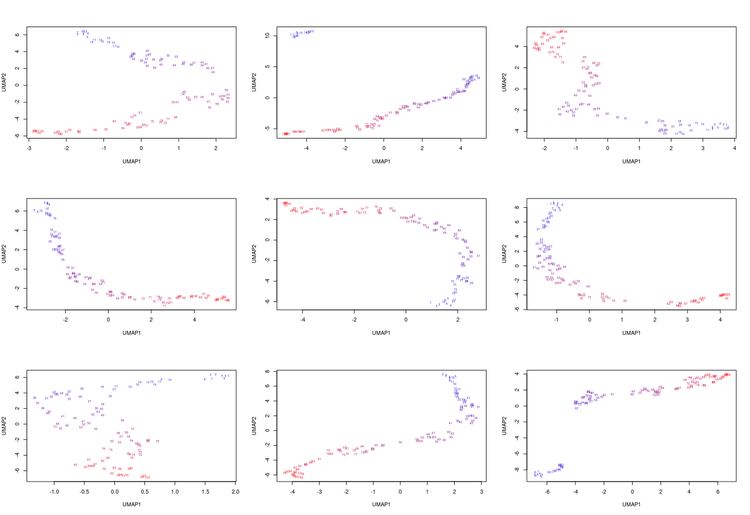
UMAP on matrix of pairwise distances (N=100)

Slide 34
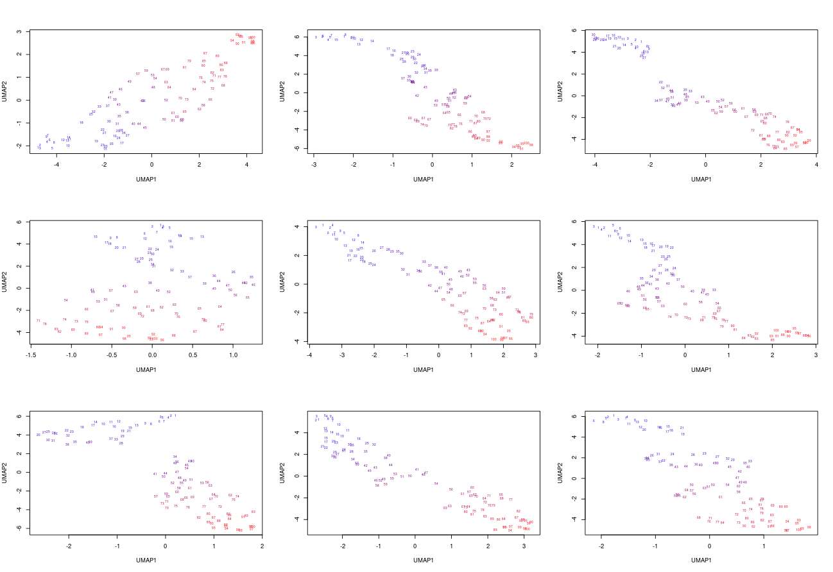
UMAP on raw data matrix (N=100)
Is N=100 OK for
statistics?

Slide 35
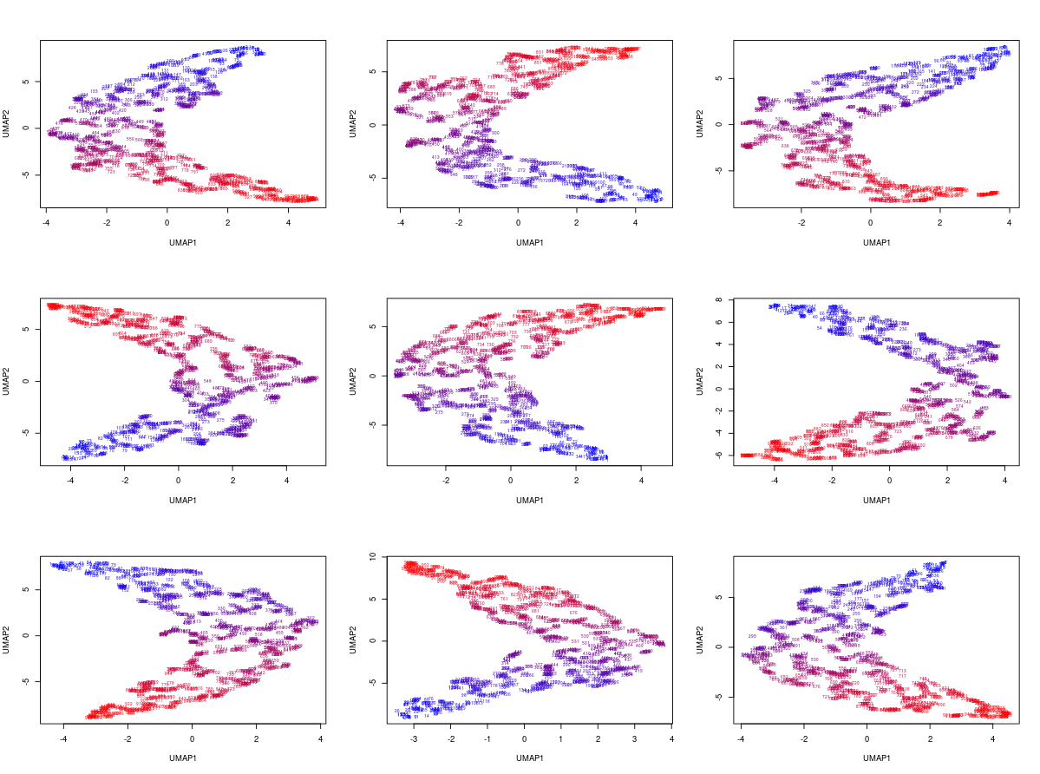
UMAP on raw data matrix (N=1000)

Slide 36

UMAP on raw data matrix (N=10 000)

Slide 37
Going through the post of Rafael Irizarry: Point2: PCA better than UMAP for PopGen!

Slide 38



PCA gold standard in PopGen: still criticized
Novembre et al., Nature 2008

Slide 39


HapMap3: UMAP vs PCA (Rafael Irizarry’s post)
UMAP
PCA
Are PUR genetically closer to GBR + IBS than ASW + YRI? ABSOLUTELY NOT!
Because of their meaningless inter-cluster distances tSNE / UMAP are less useful for population genomics than PCA
The goal of tSNE / UMAP is to discover clusters, which is sufficient for Single Cell Biology but not for PopGen.
In PopGen we generally do not discover clusters, we have an idea about e.g. human populations, and the aim is often to explore the genetic relatedness between the populations, a task UMAP can absolutely not solve!

Slide 40
UMAP for data integration

Slide 41





Graph Intersection Method
Hamming distance
Euclidean distance
Hamming distance
Keep edges consistently present across the Omics

Slide 42



UMAP for data integration: CITEseq

Slide 43




National Bioinformatics Infrastructure Sweden (NBIS)

